Slide 1
MENA CONCENTRATION & ECONOMIC OUTCOMES
(Michigan only)

Slide 2
SUMMARY STATISTICS OF MENA CONCENTRATION

Slide 3
Summary Stats – All Tracts
No. of tracts | 3,017
Mean | 0.02
Std. Dev. | 0.076
Median | 0
Min. | 0
Max. | 0.883
Percentile | MENA concentration
1 | 0
25 | 0
50 | 0
75 | 0
90 | 0.0517
95 | 0.0974
99 | 0.3945
Most tracts (in MI) have no MENA concentration whatsoever
Only ~20% of tracts have nonzero MENA concentration

Slide 4
County | MSA (if applicable) | # of tracts
Oakland | Detroit-Warren-Dearborn, MI MSA | 185
Wayne | Detroit-Warren-Dearborn, MI MSA | 157
Macomb | Detroit-Warren-Dearborn, MI MSA | 131
Washtenaw | Ann Arbor, MI MSA | 46
Ingham | Lansing-East Lansing, MI MSA | 27
Genesee | Flint, MI MSA | 16
Kent | Grand Rapids-Wyoming-Kentwood, MI MSA | 12
Kalamazoo | Kalamazoo-Portage, MI MSA | 7
Branch |  | 3
Eaton | Lansing-East Lansing, MI MSA | 3
Clinton | Lansing-East Lansing, MI MSA | 2
Livingston | Detroit-Warren-Dearborn, MI MSA | 2
Monroe | Monroe, MI MSA | 2
Saginaw | Saginaw, MI MSA | 2
St. Clair | Detroit-Warren-Dearborn, MI MSA | 2
Isabella |  | 1
Ottawa | Grand Rapids-Wyoming-Kentwood, MI MSA | 1
Where are the tracts where MENA concentration >0 ?
All but 4 sampled tracts with nonzero MENA concentration are located within a metropolitan statistical area (MSA)
The Detroit metro area contains about 80% of the tracts with nonzero MENA concentration
For this reason, it is worth comparing outcomes in the Detroit area with the rest of Michigan

Slide 5
Summary Stats – Tracts w/ Nonzero MENA Concentration
No. of tracts | 599
Mean | 0.102
Std. Dev. | 0.143
Median | 0.0518
Min. | 0.0134
Max. | 0.883
Percentile | MENA concentration
1 | 0.0151
25 | 0.0329
50 | 0.0518
75 | 0.0982
90 | 0.2384
95 | 0.4006
99 | 0.8318

Slide 6
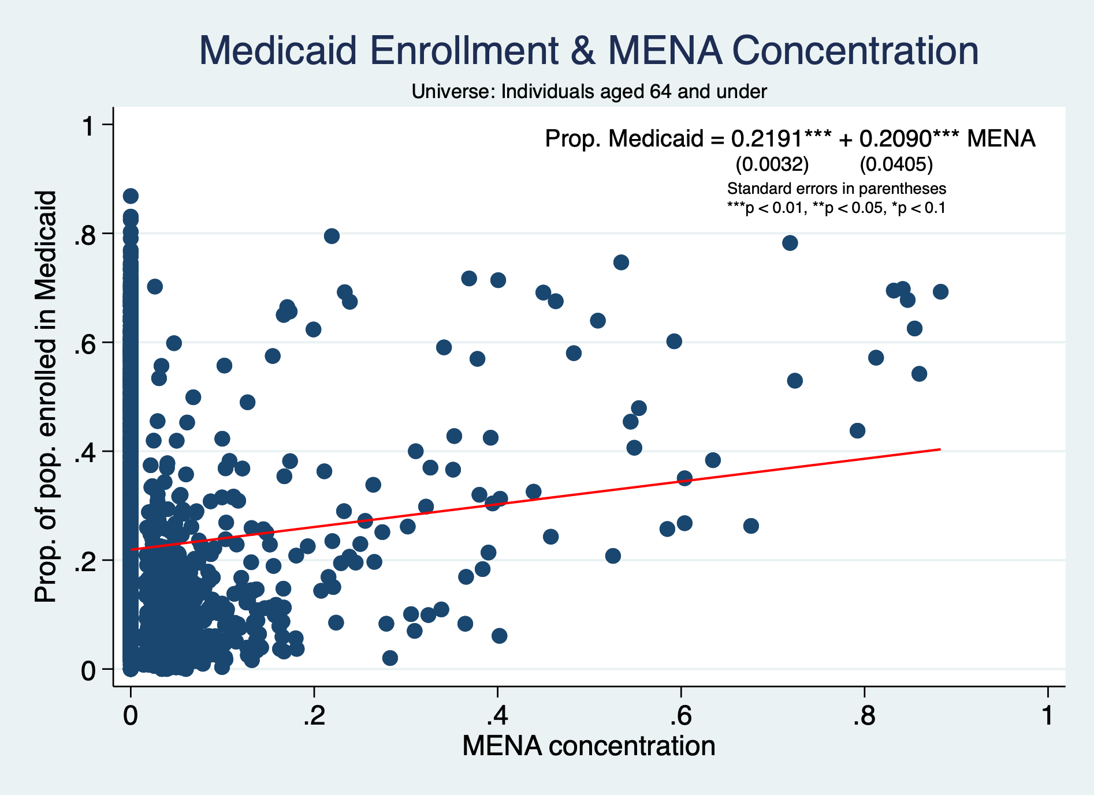

Slide 7
IMPORTANT NOTES ABOUT CHARTS

Slide 8
Scope of all charts is ALL CENSUS TRACTS IN MICHIGAN unless noted otherwise
For betas of all scatterplots:
Standard errors in parentheses
***p < 0.01, **p < 0.05, *p < 0.1
For bar charts sorted by MENA concentration:
”Median” refers to median MENA concentration of tracts with nonzero MENA concentration
For Michigan, this is 0.0518

Slide 9
INCOME

Slide 10
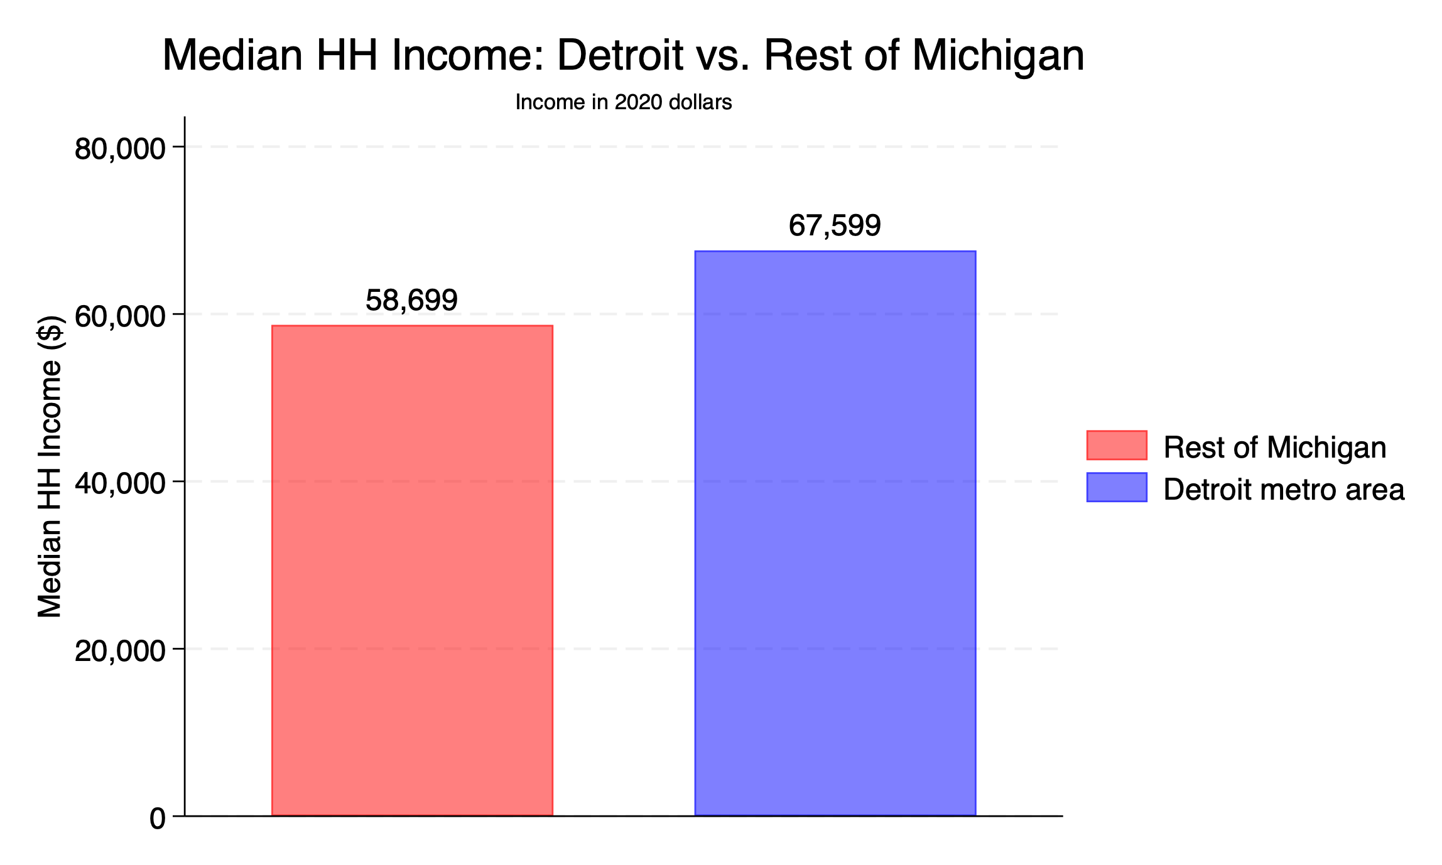

Slide 11
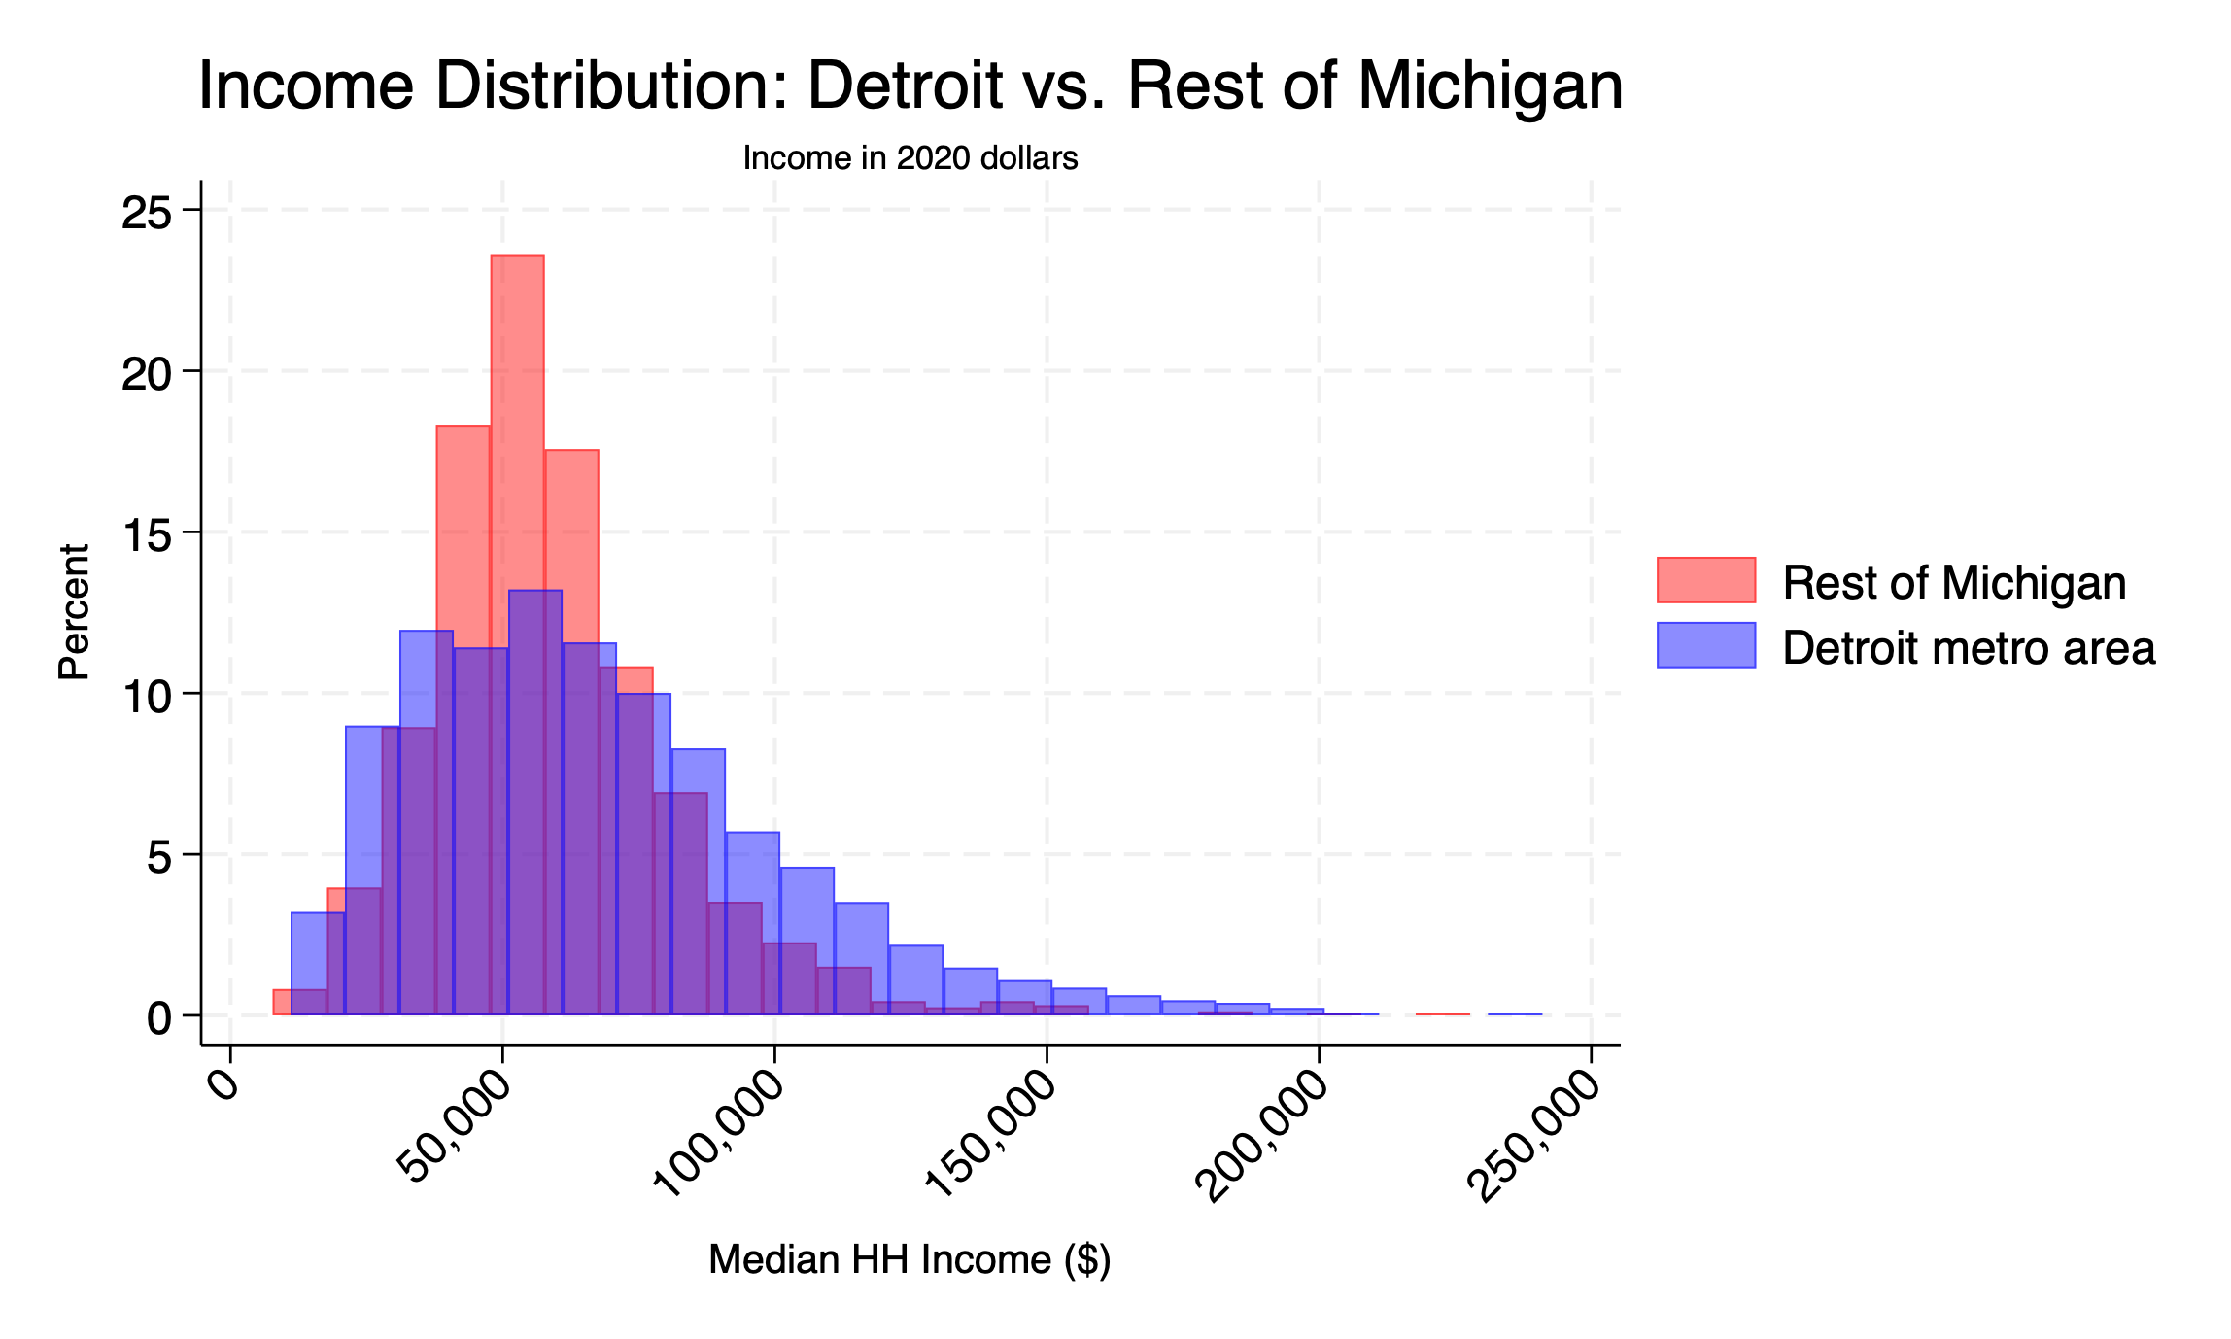

Slide 12
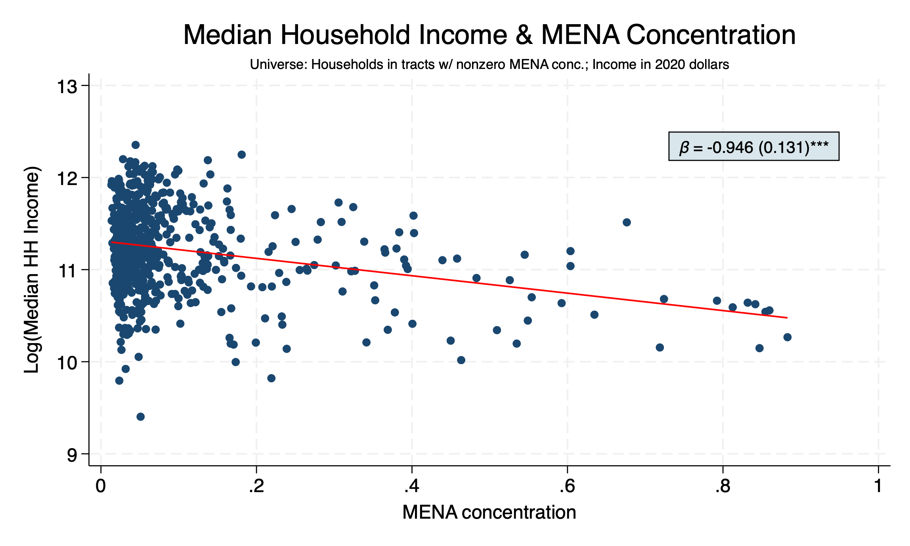

Slide 13
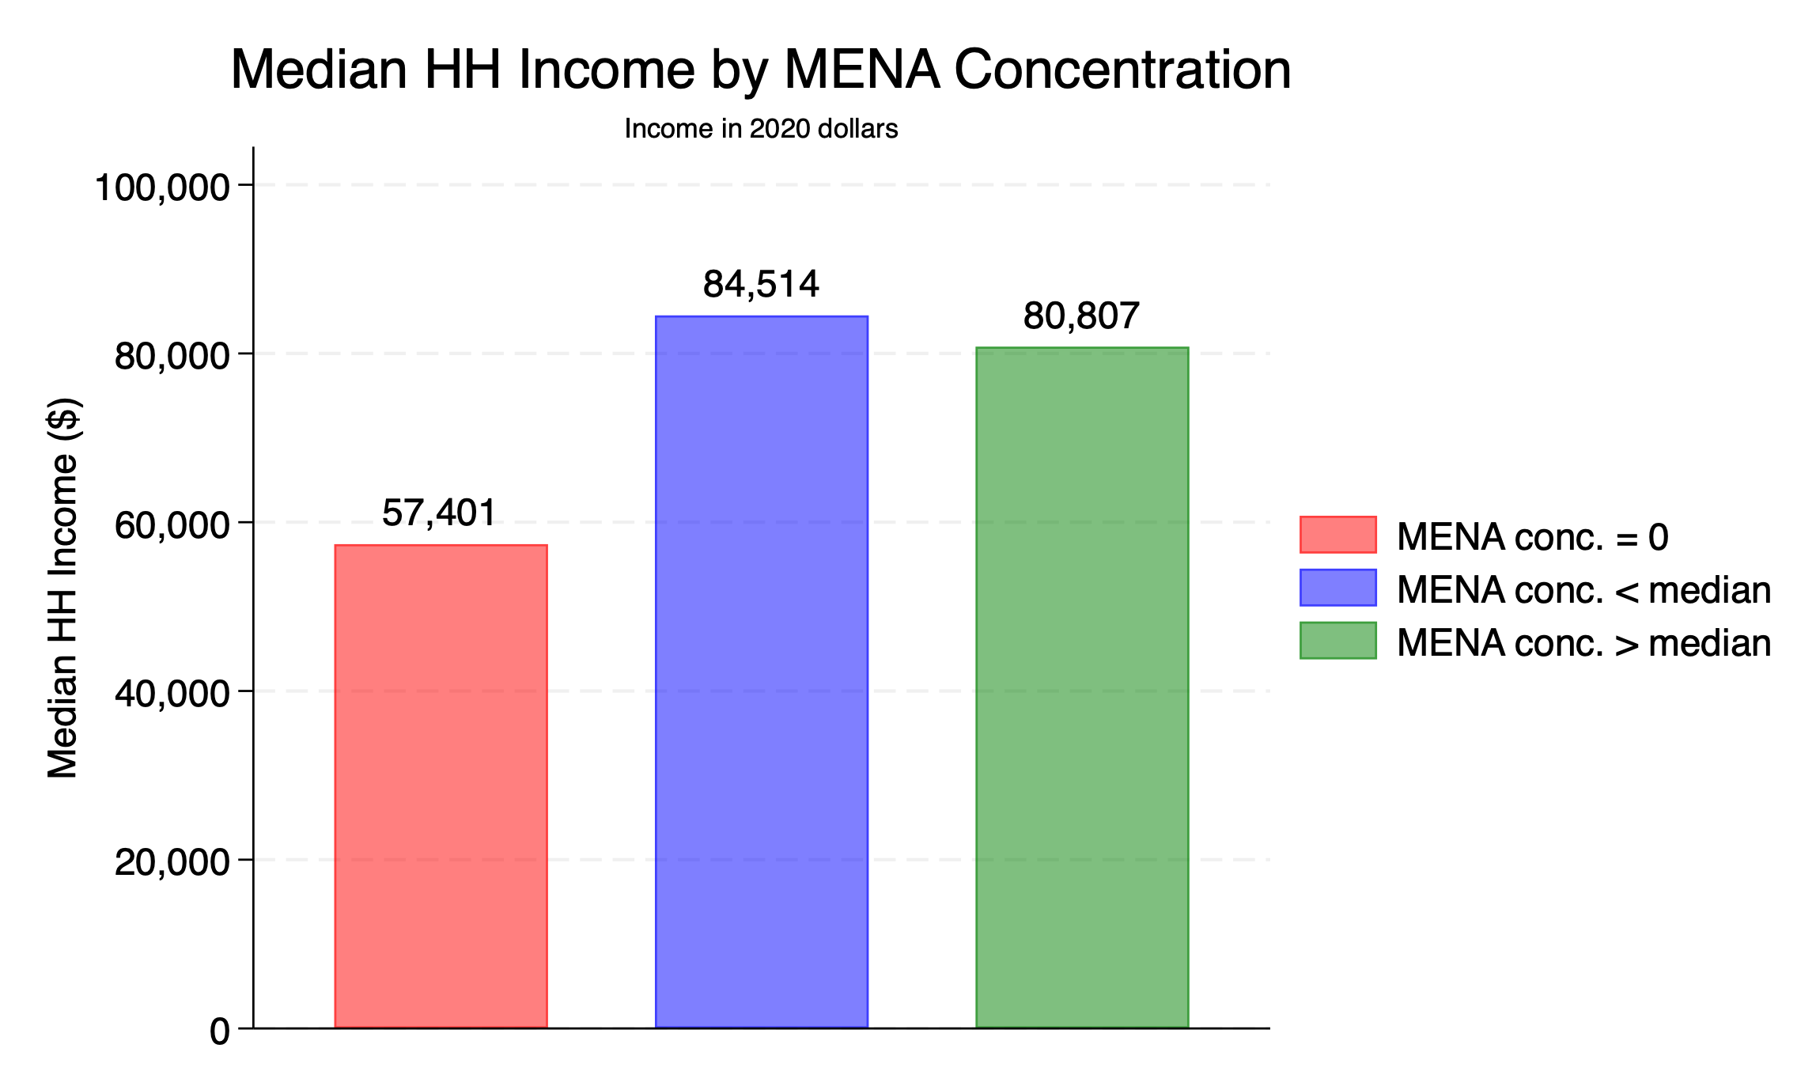

Slide 14
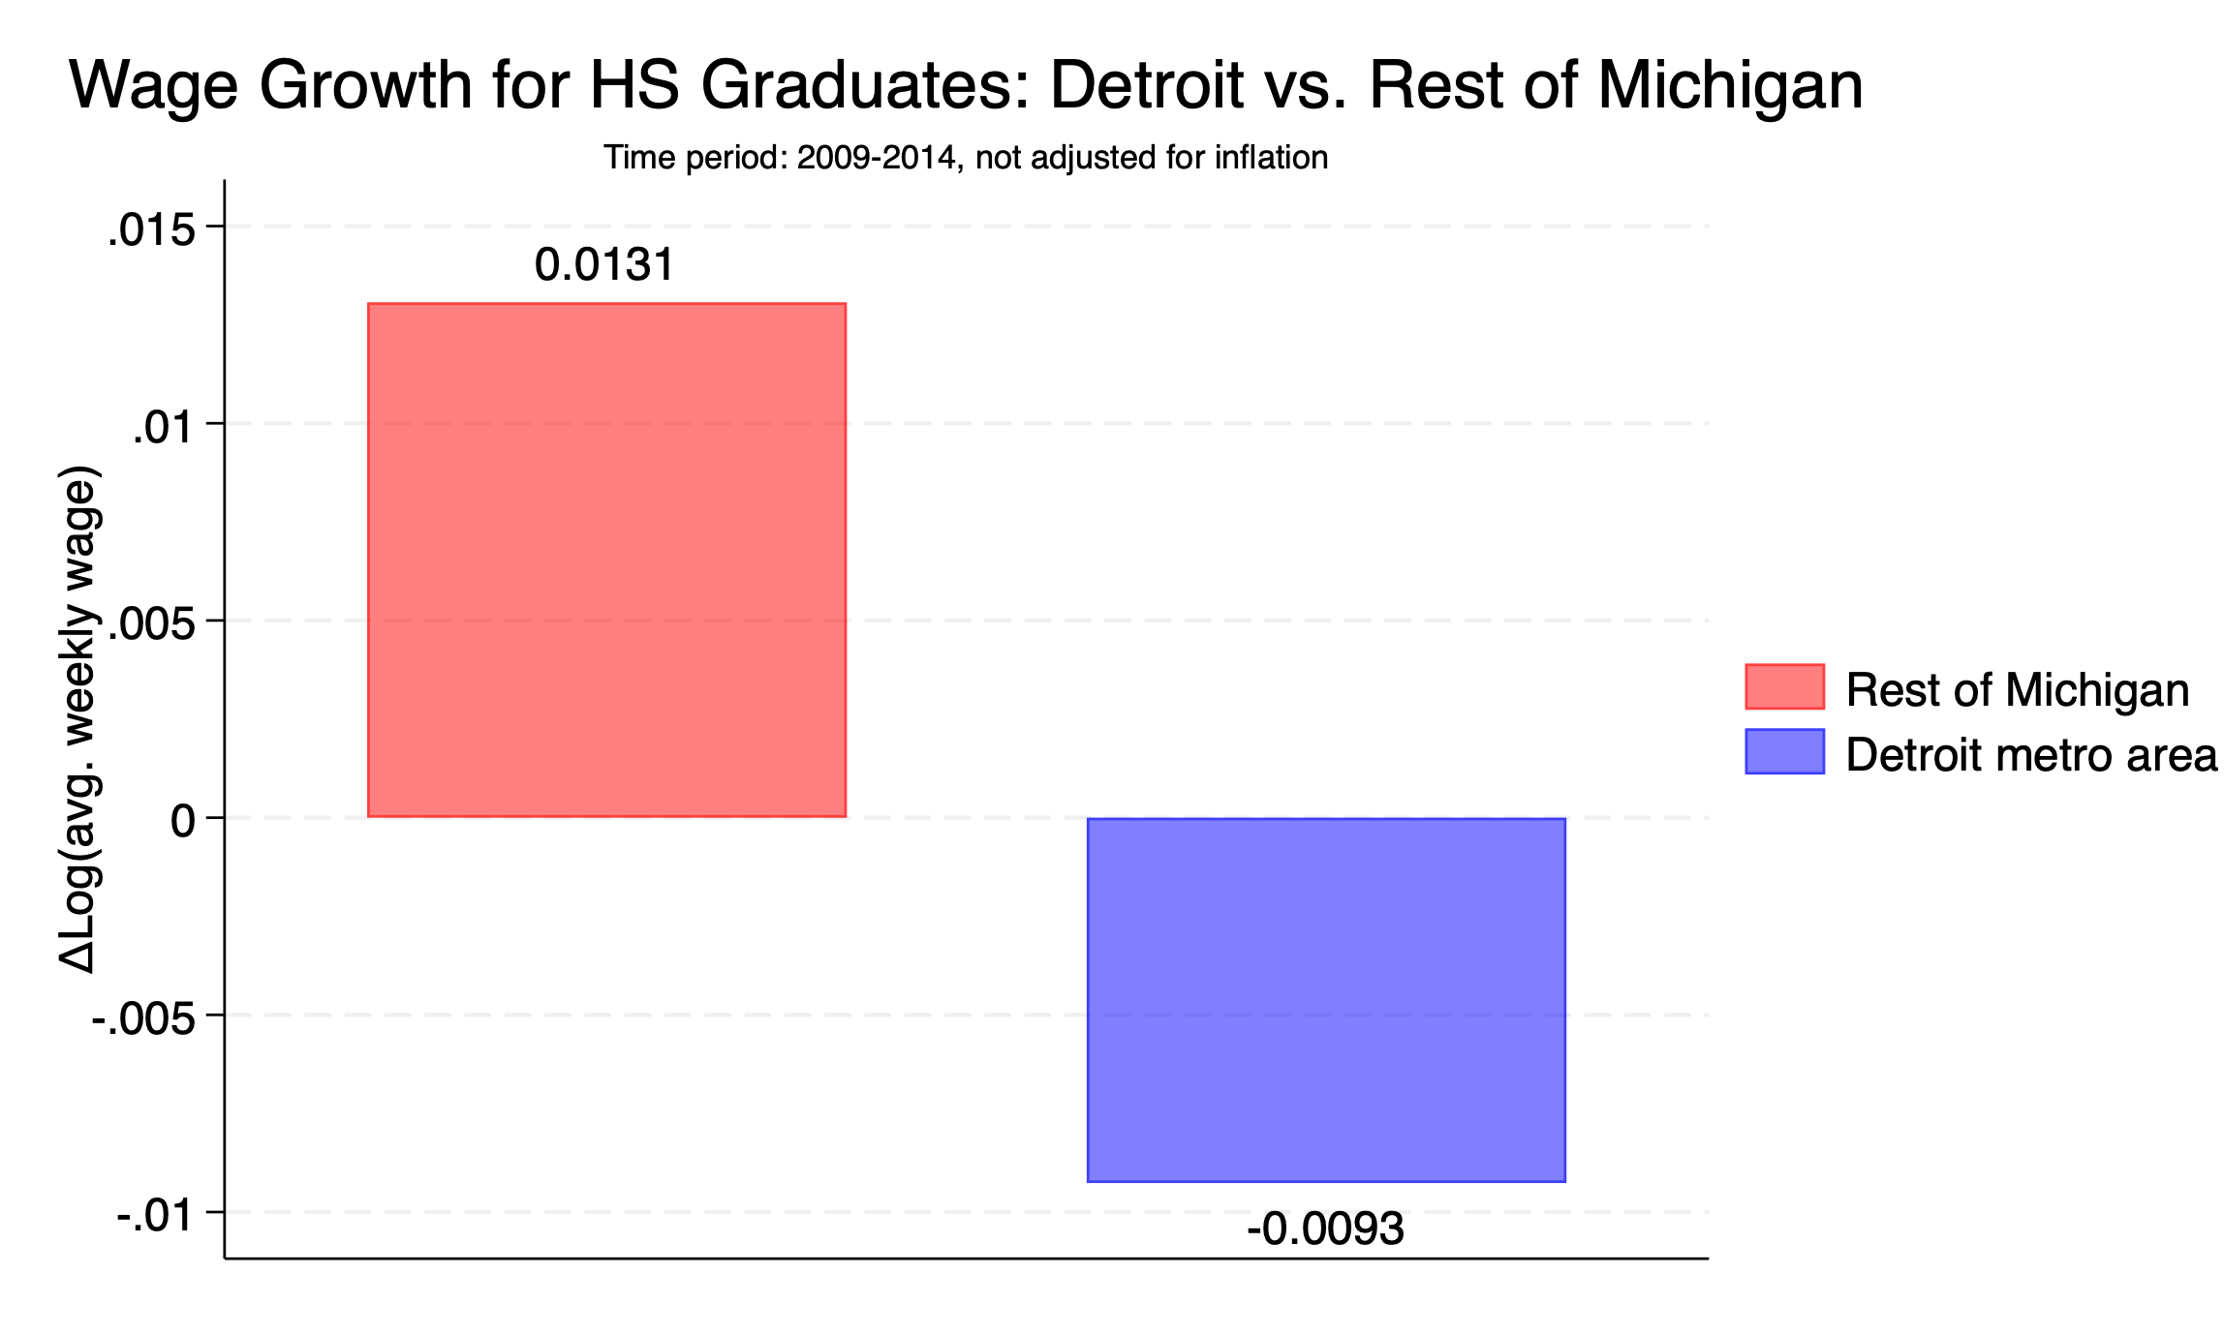

Slide 15
PUBLIC ASSISTANCE

Slide 16
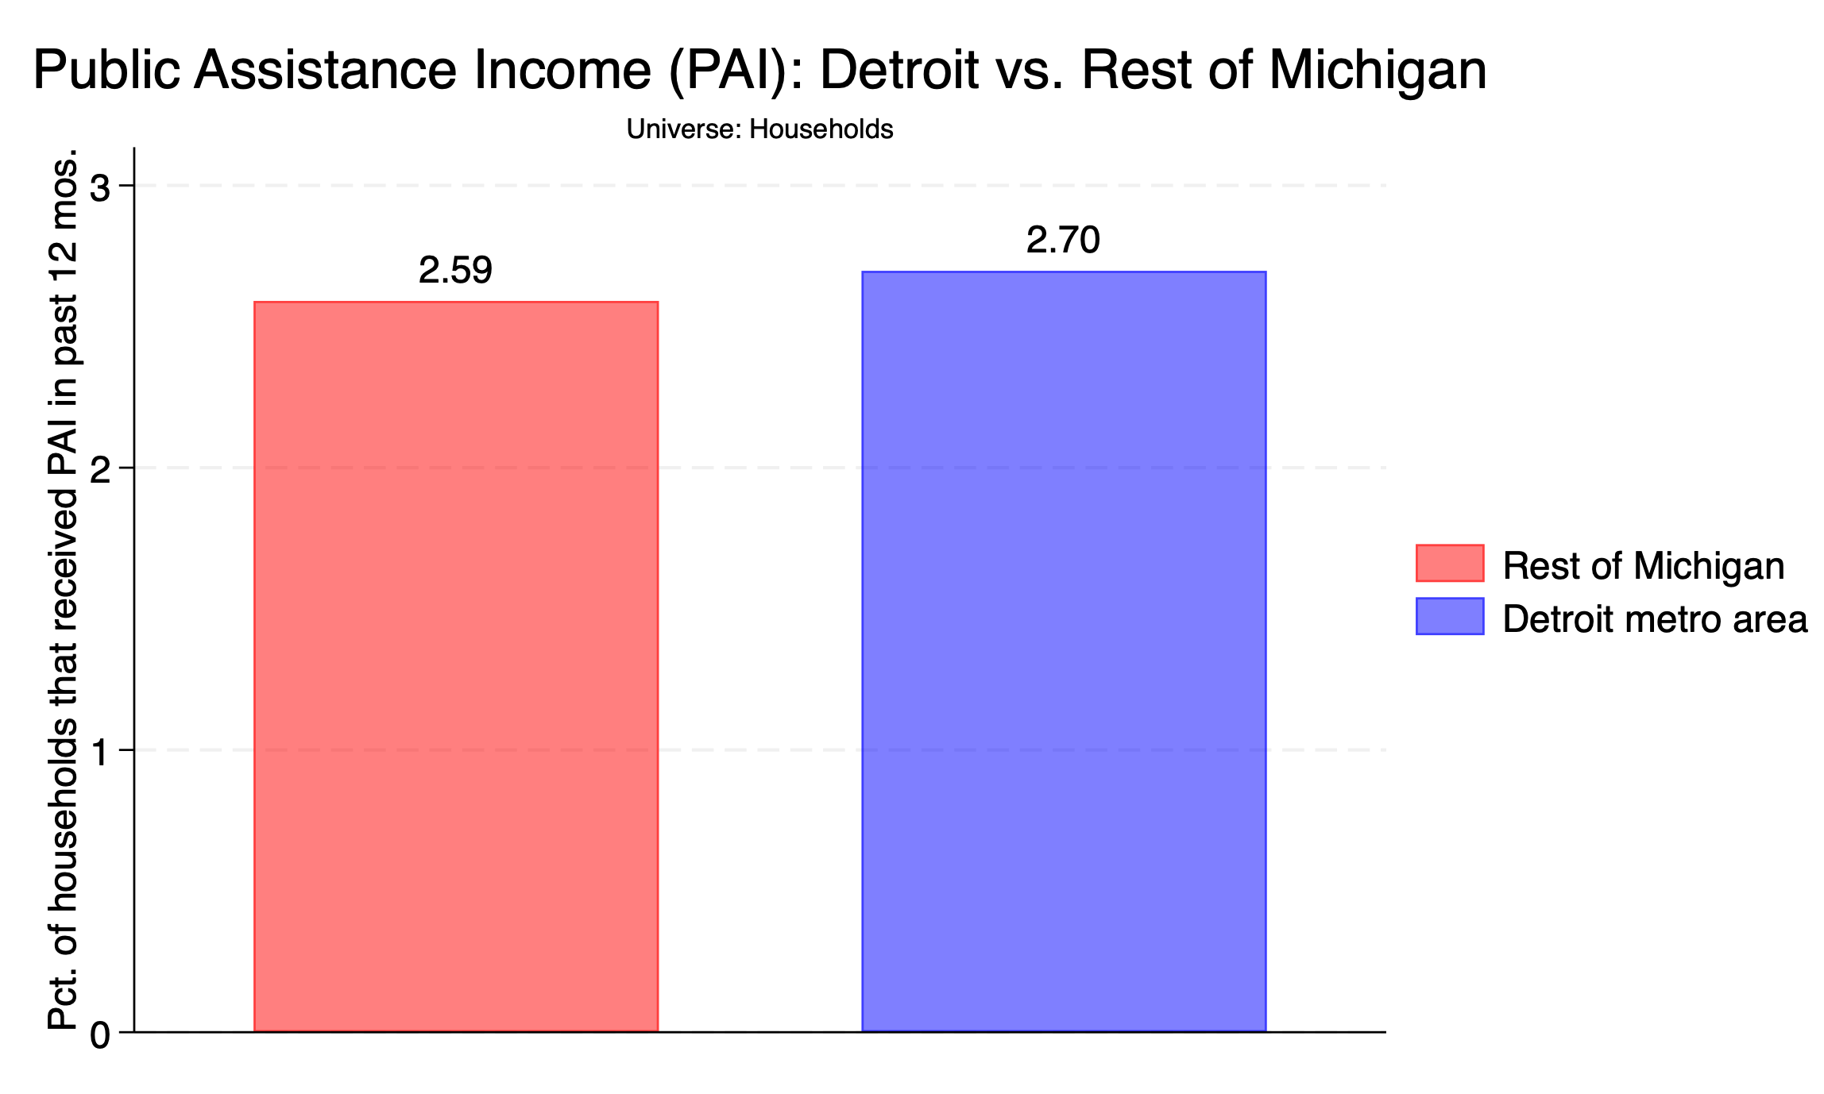

Slide 17
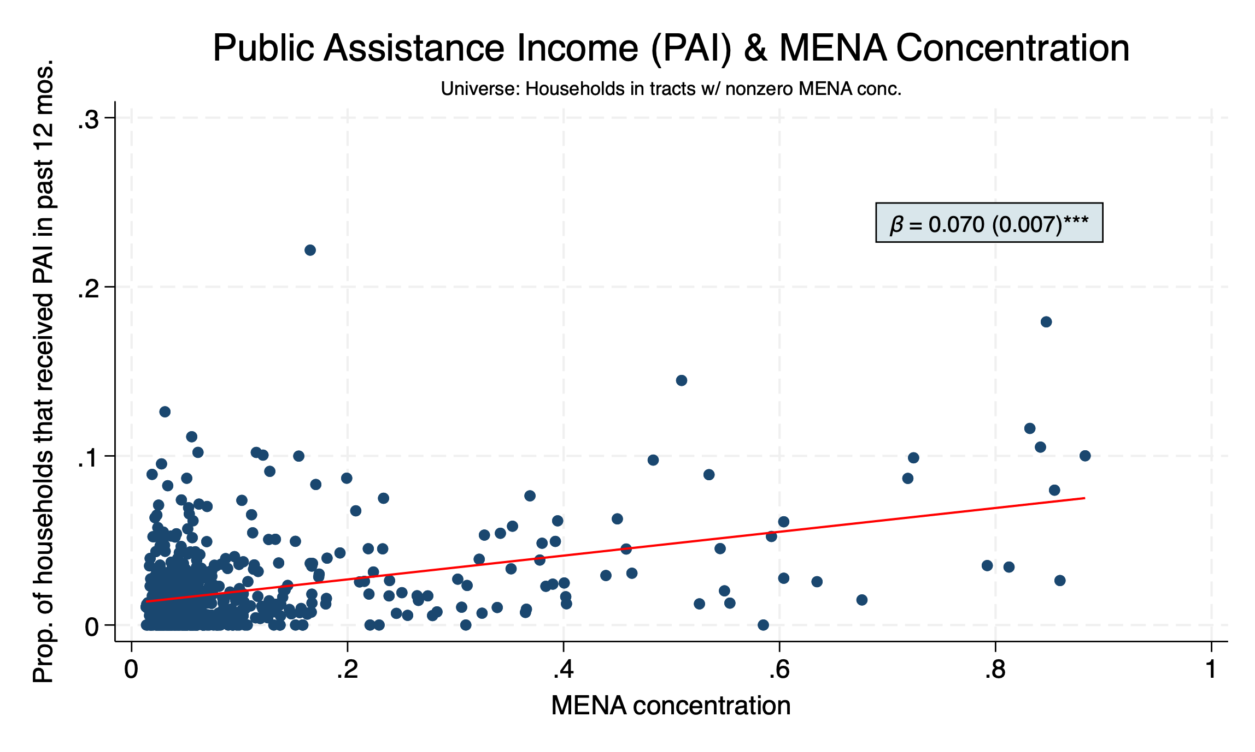

Slide 18
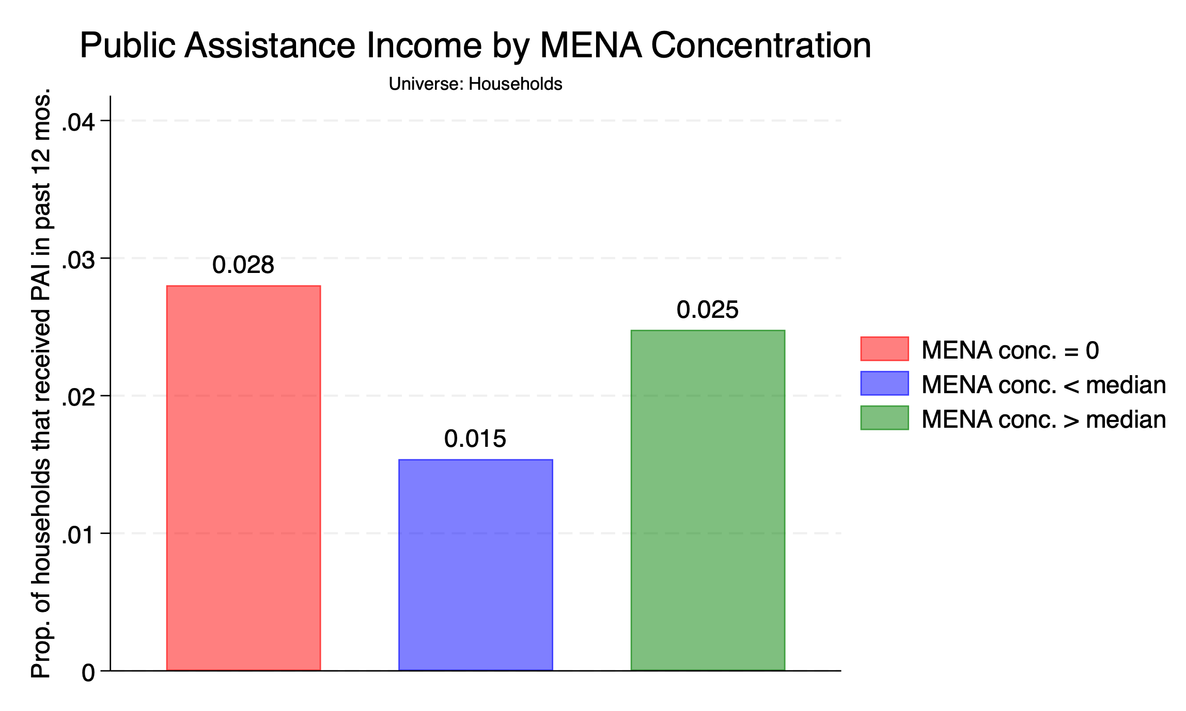

Slide 19
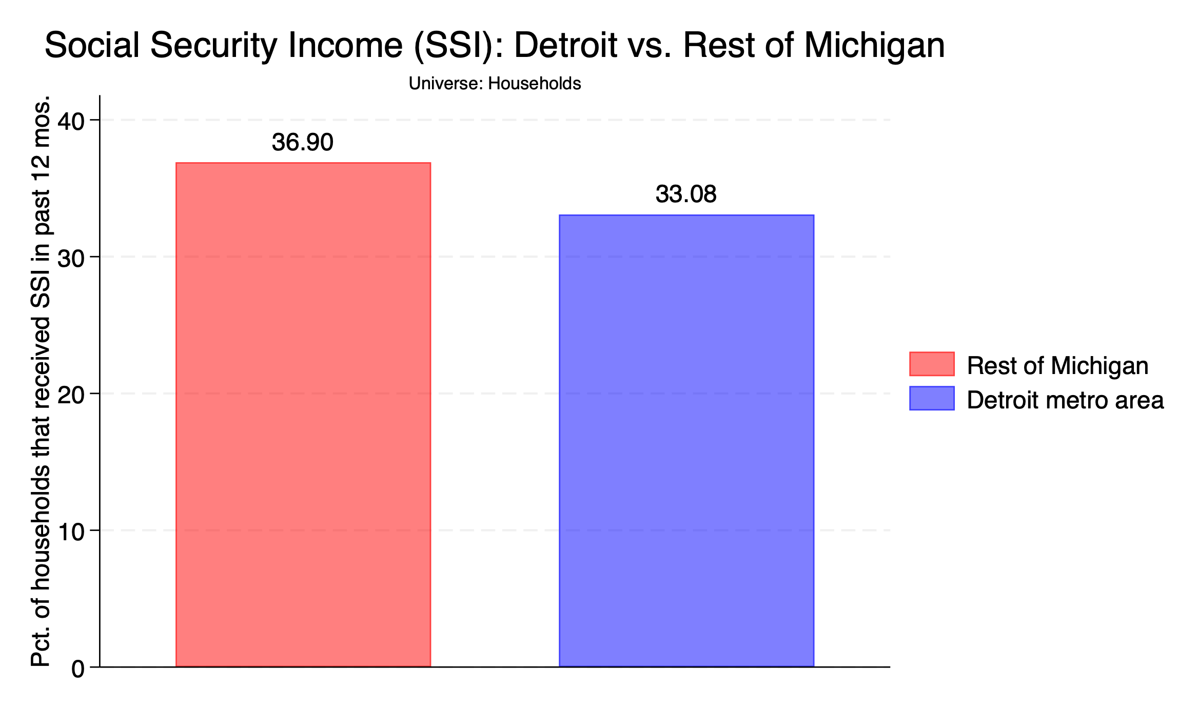

Slide 20
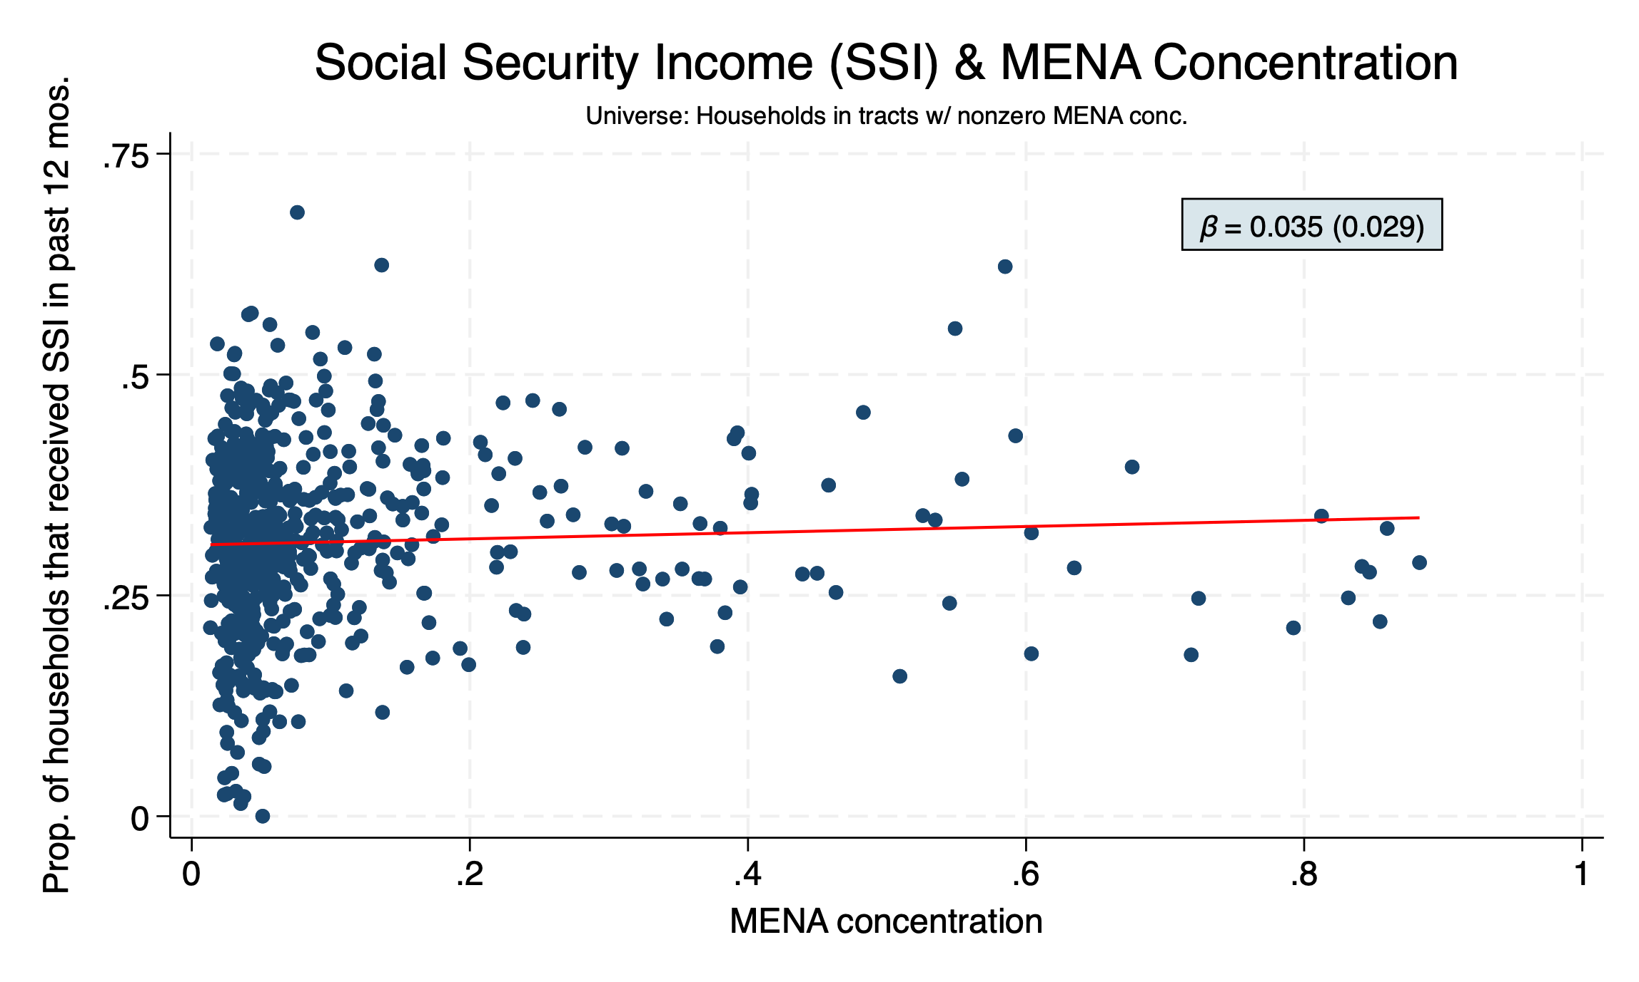

Slide 21
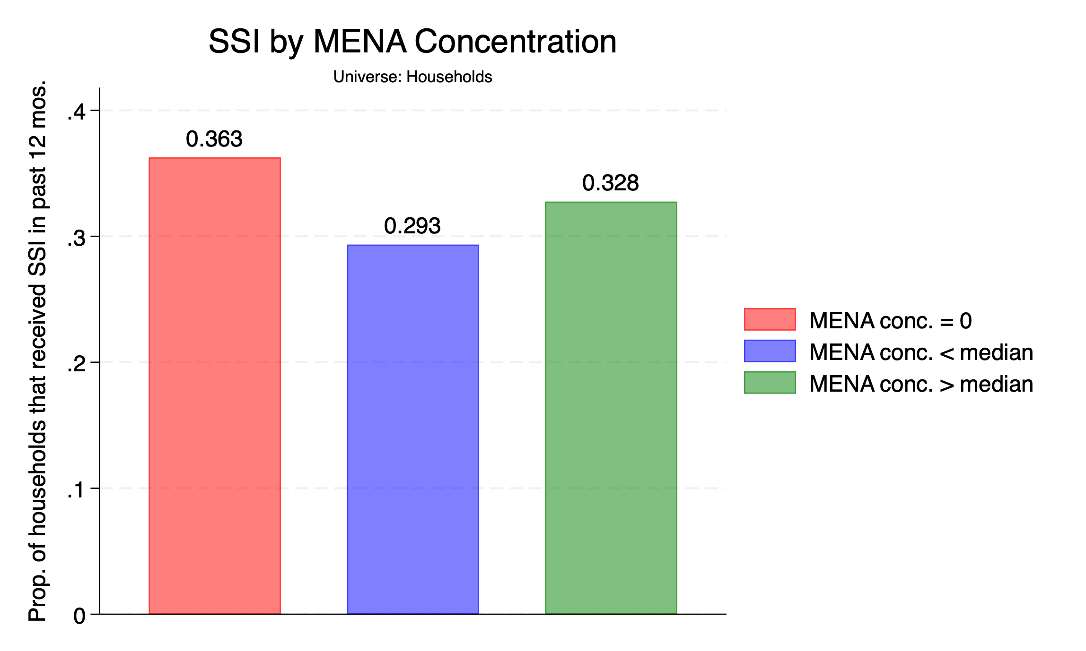

Slide 22
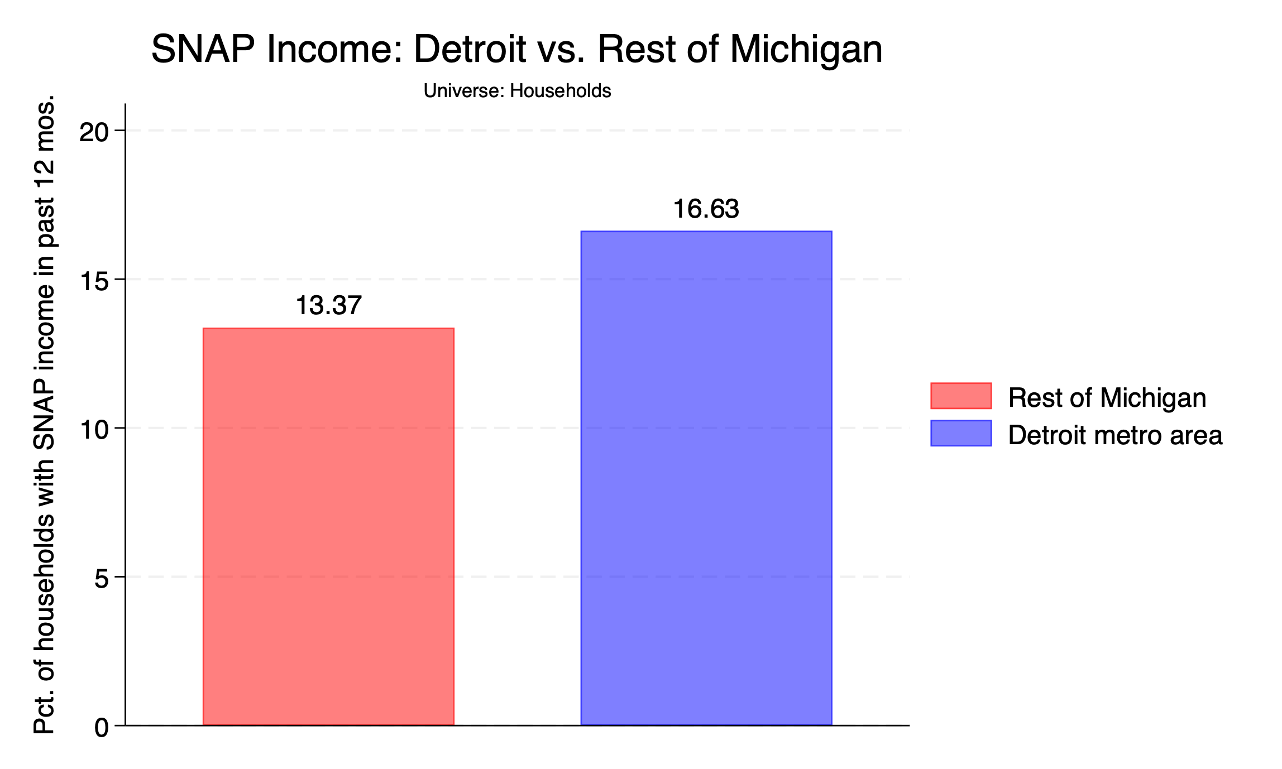

Slide 23


Slide 24
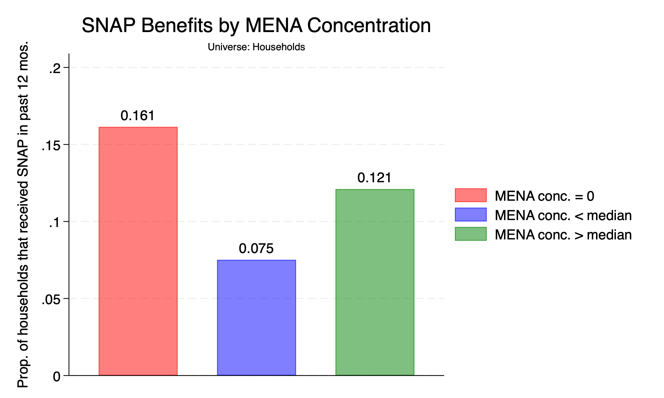

Slide 25
LABOR MARKET OUTCOMES

Slide 26
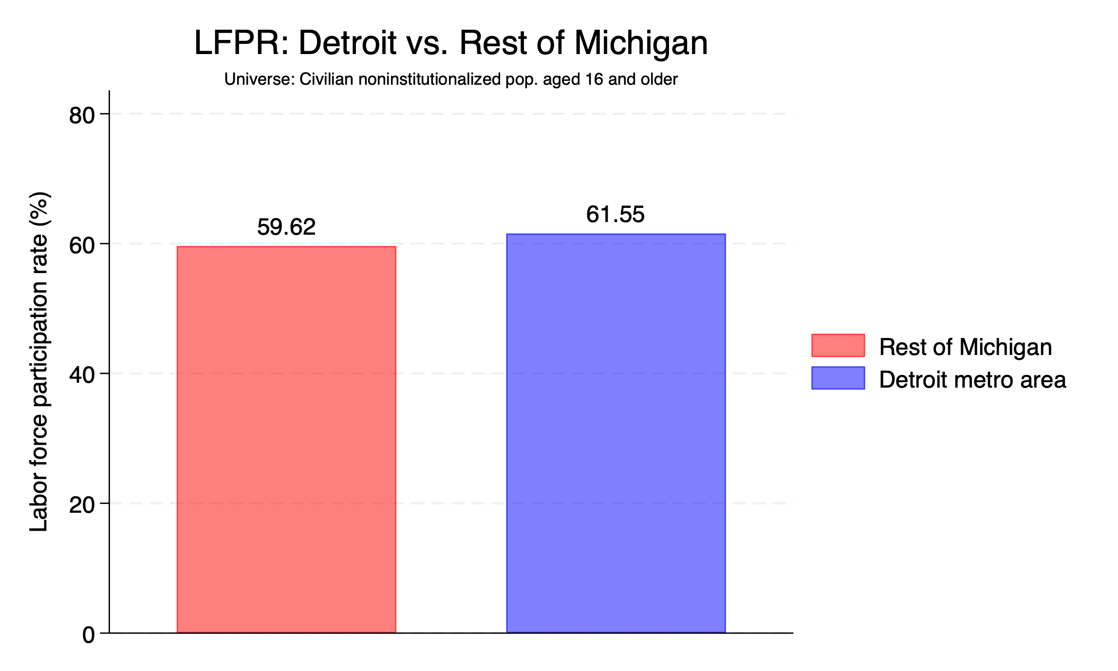

Slide 27
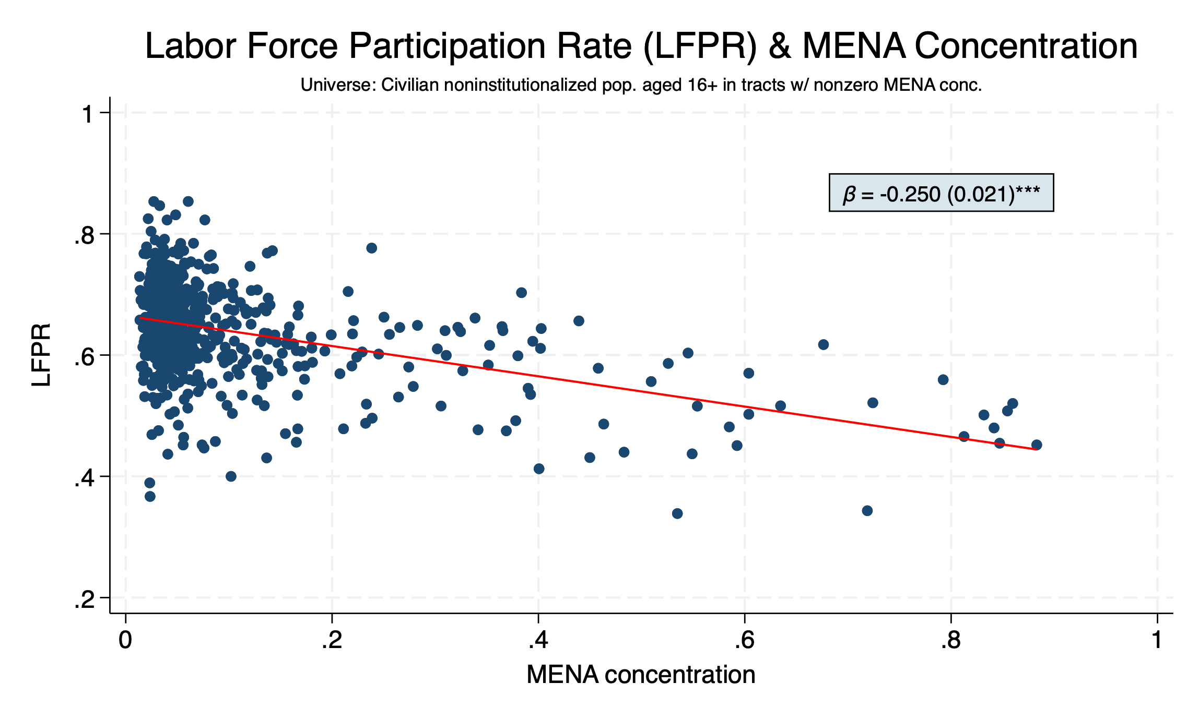

Slide 28
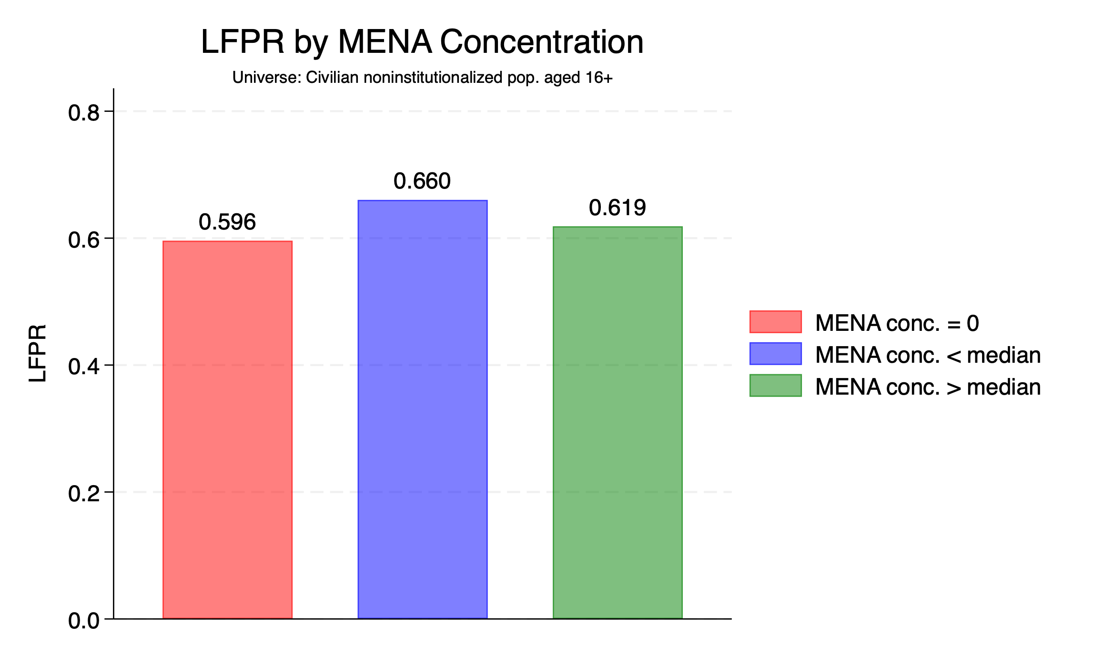

Slide 29
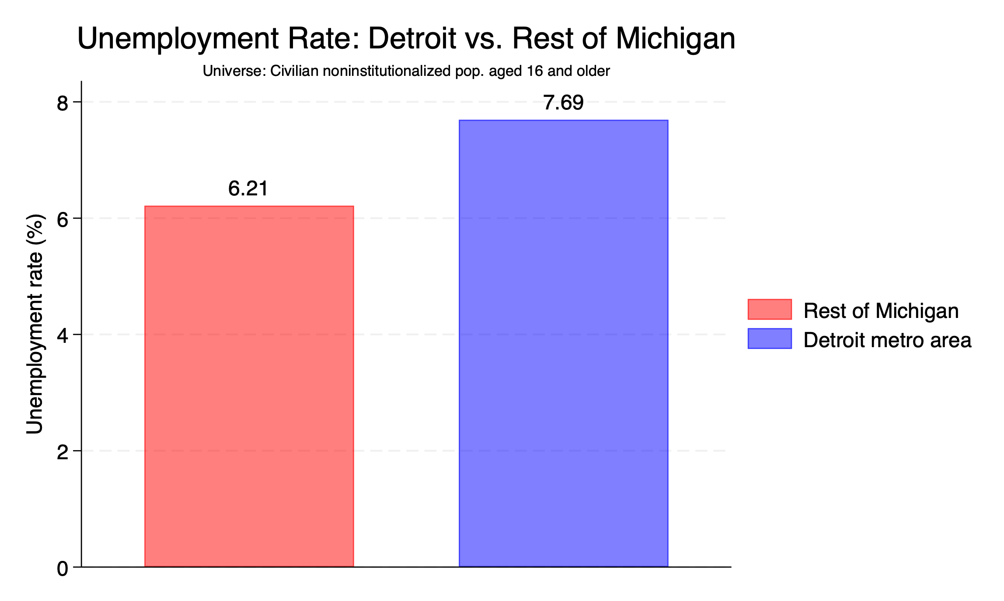

Slide 30
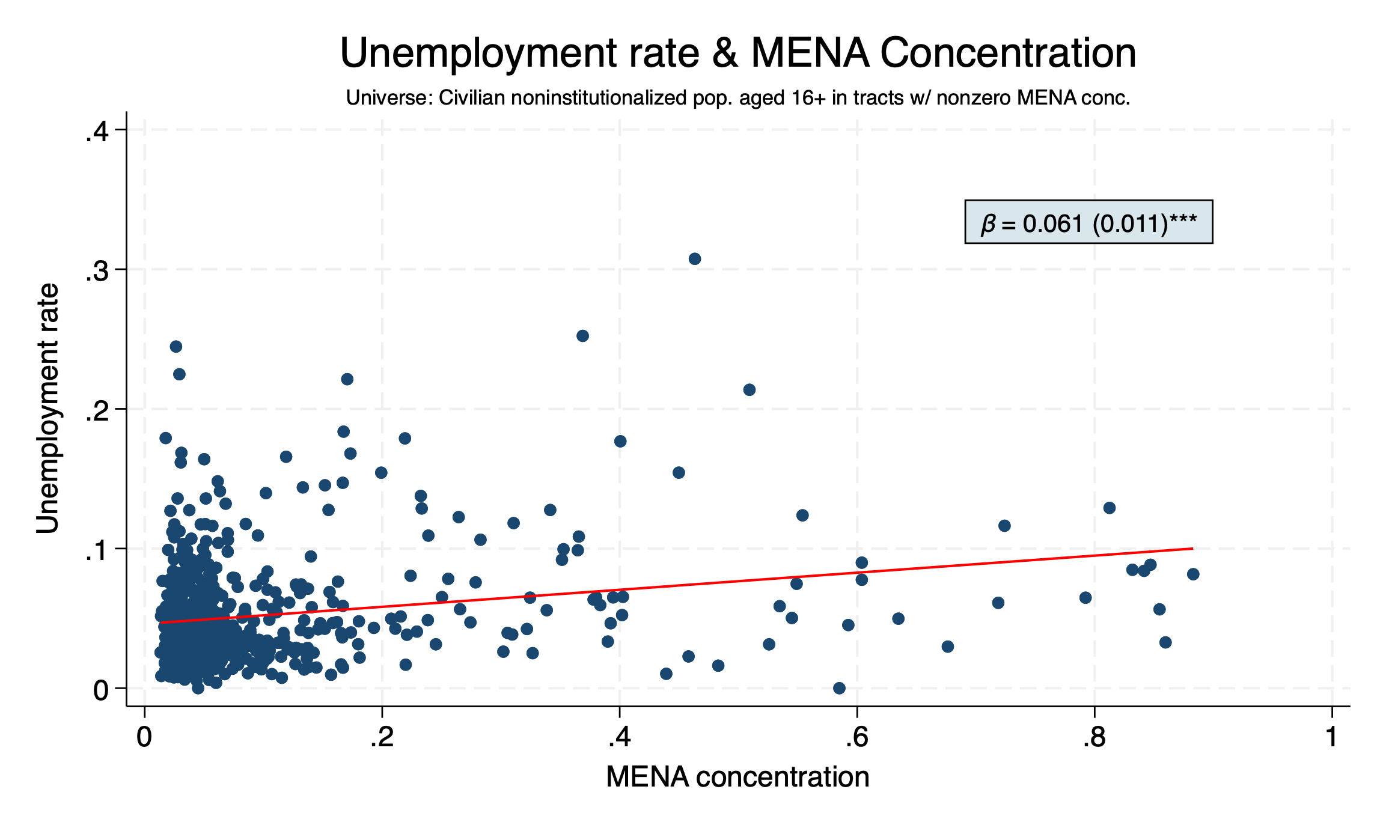

Slide 31
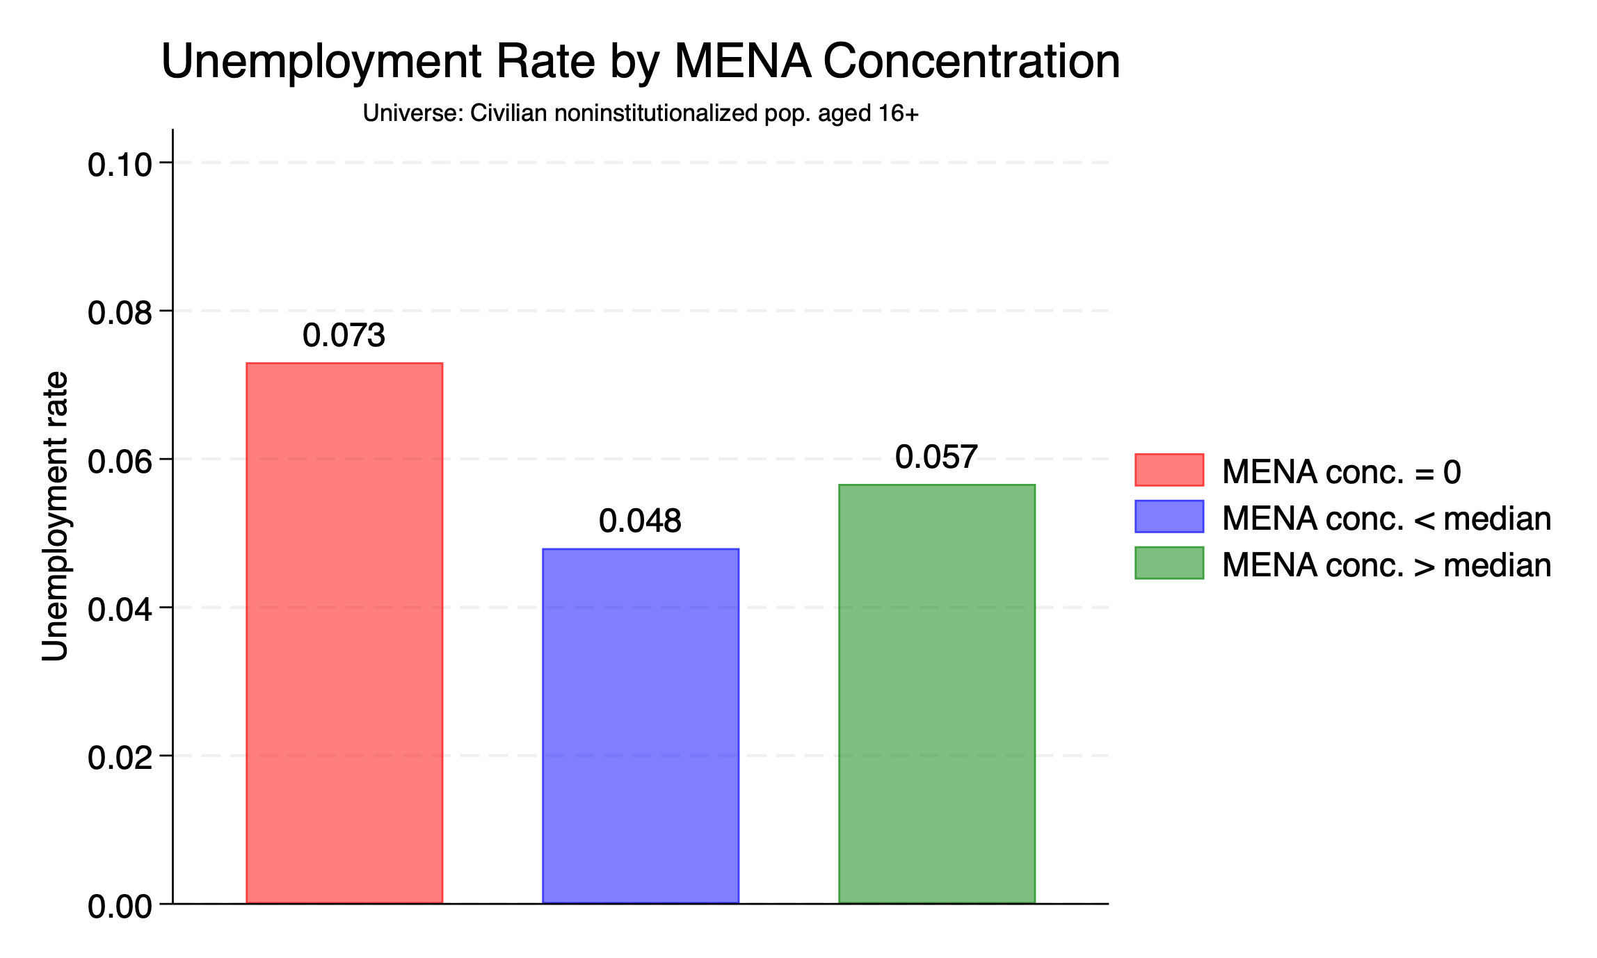

Slide 32
HEALTH

Slide 33
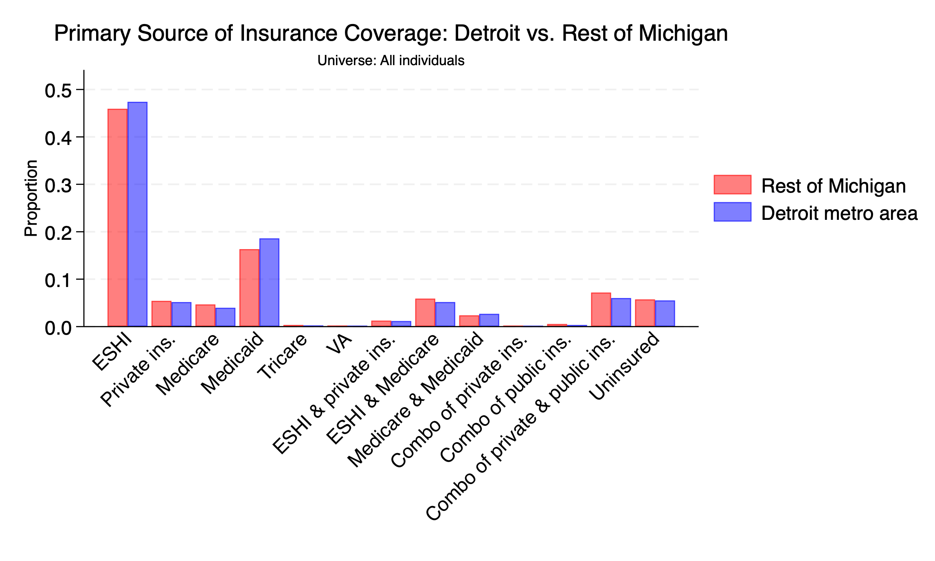

Slide 35
HOUSING

Slide 36
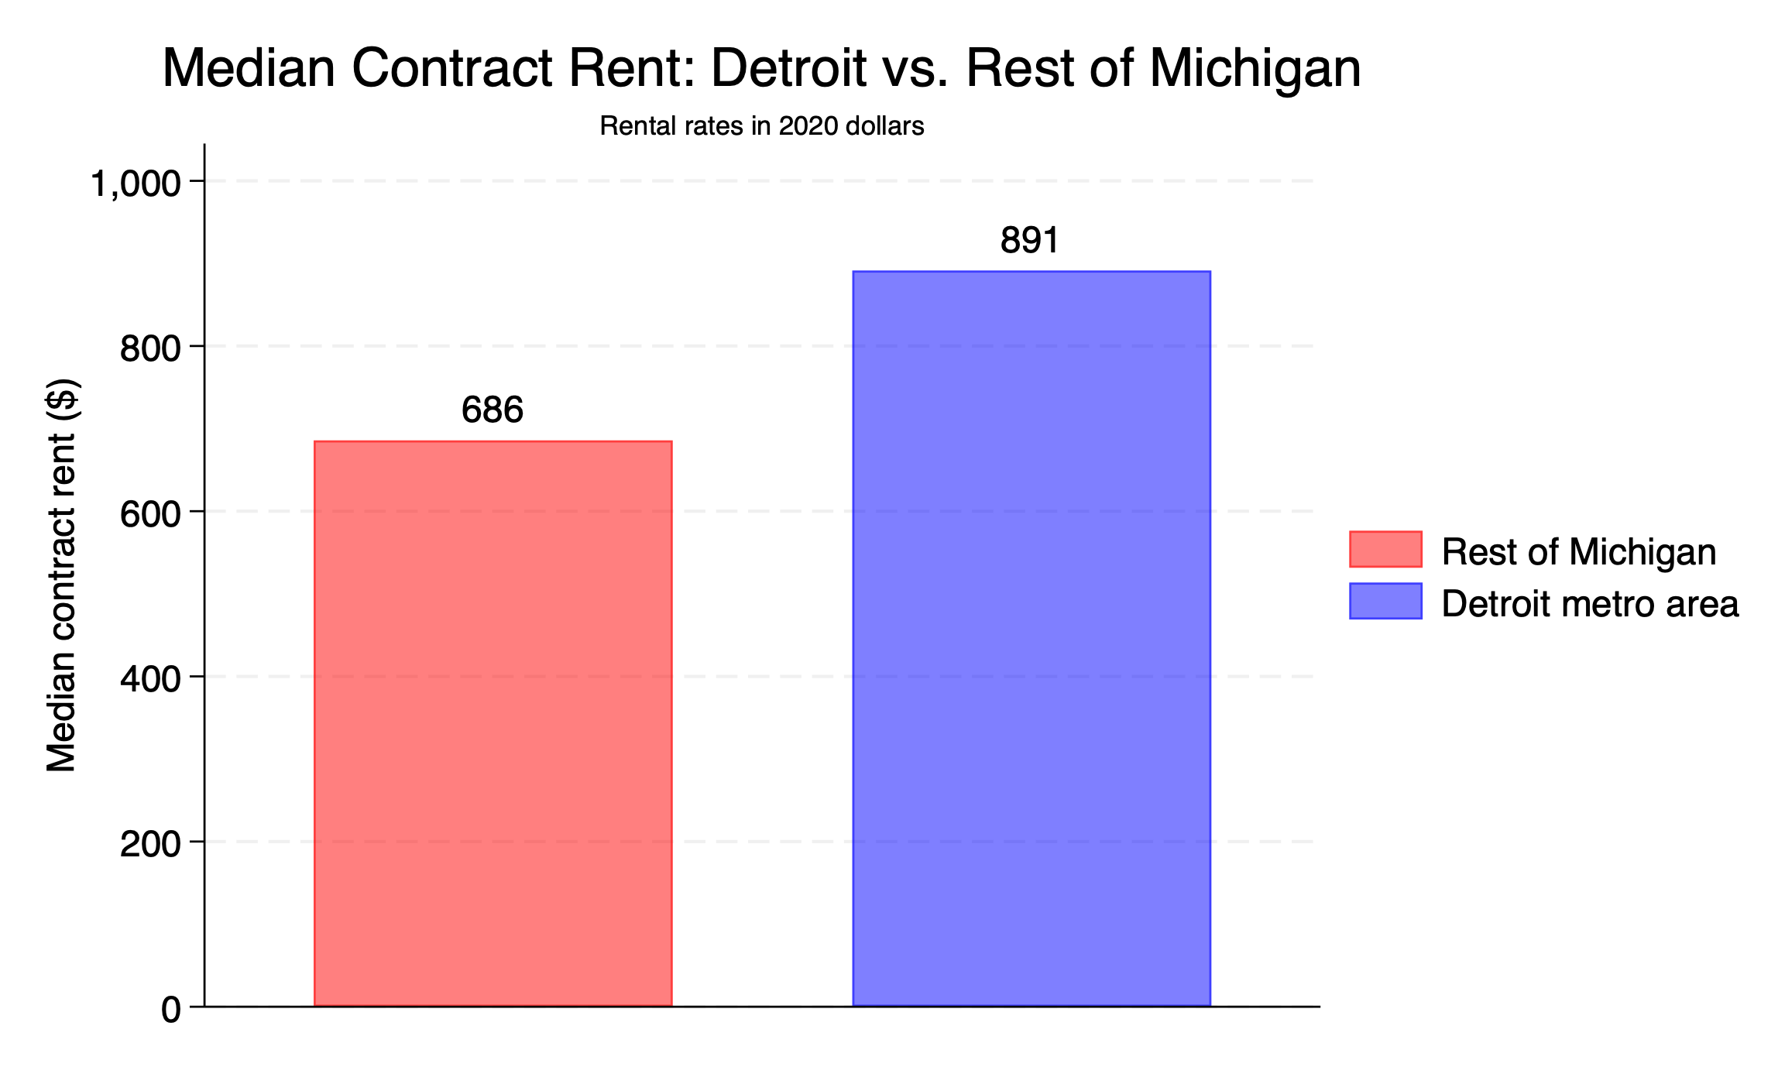

Slide 37
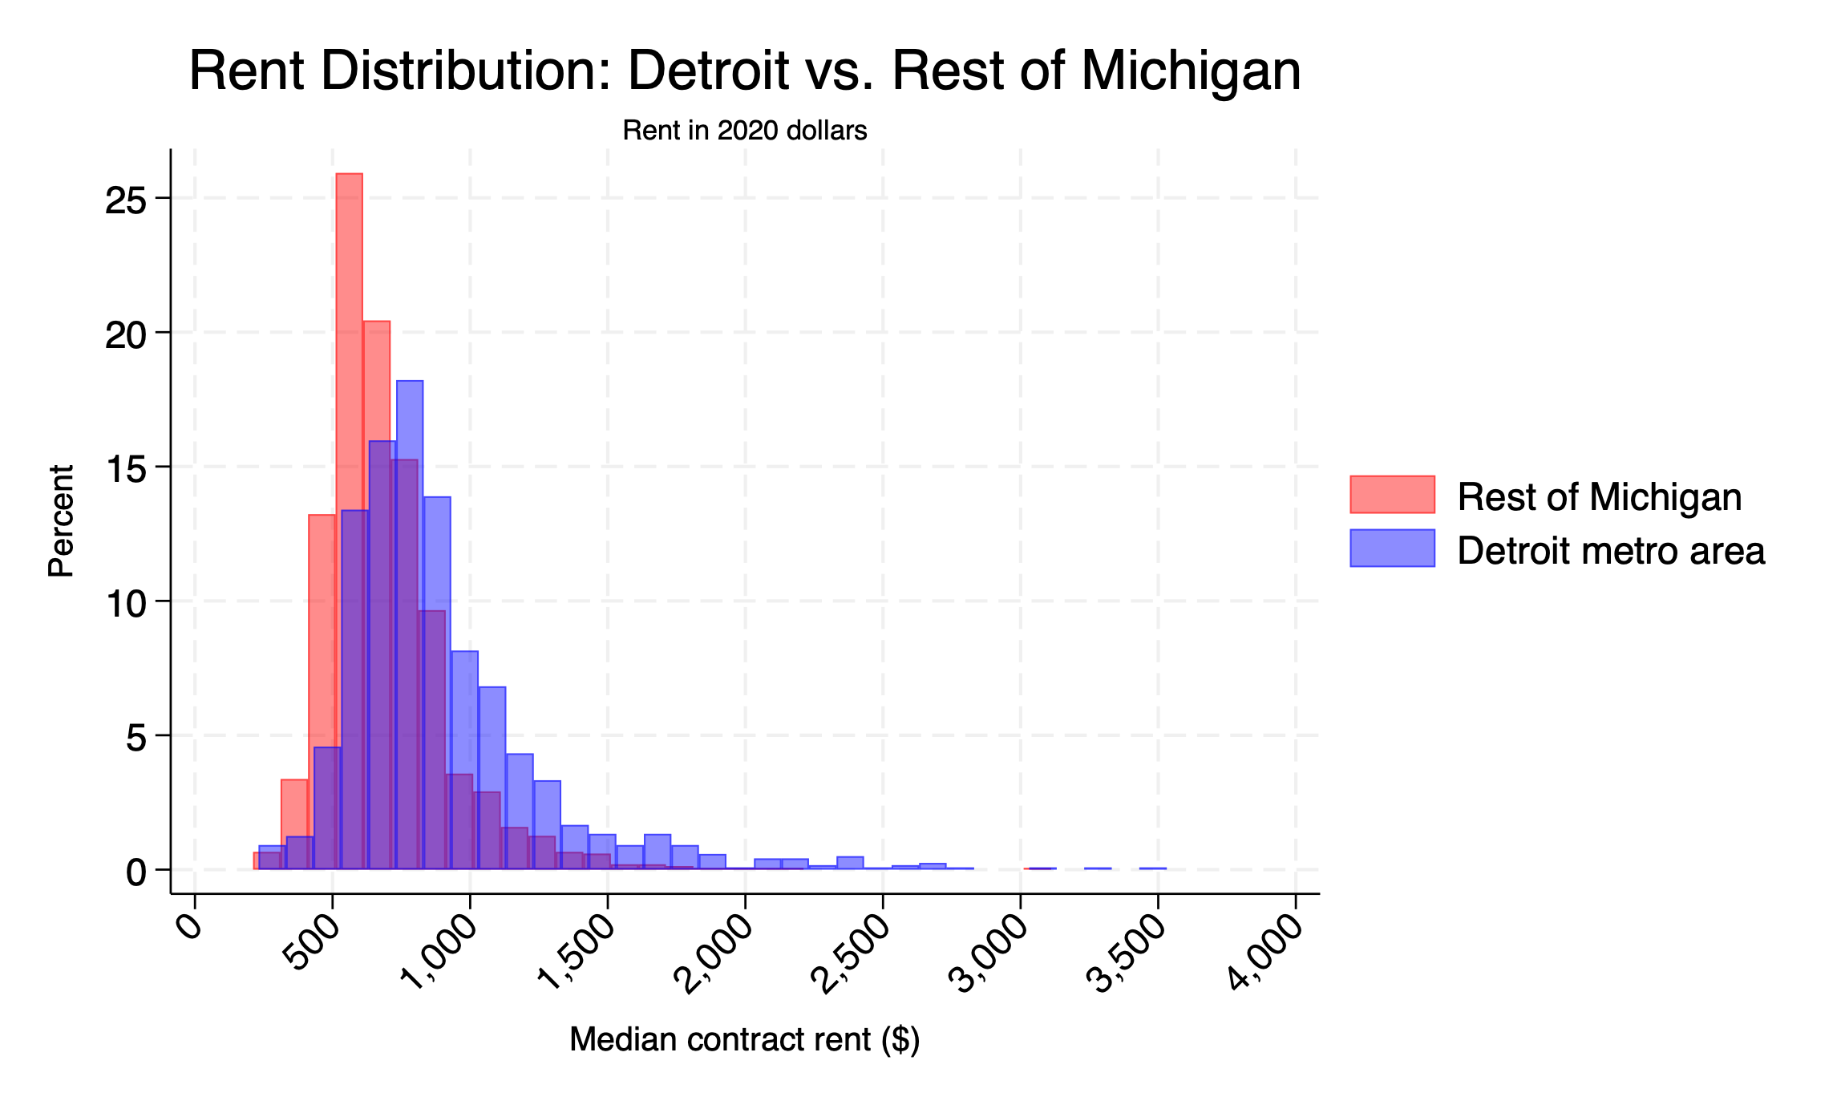

Slide 38
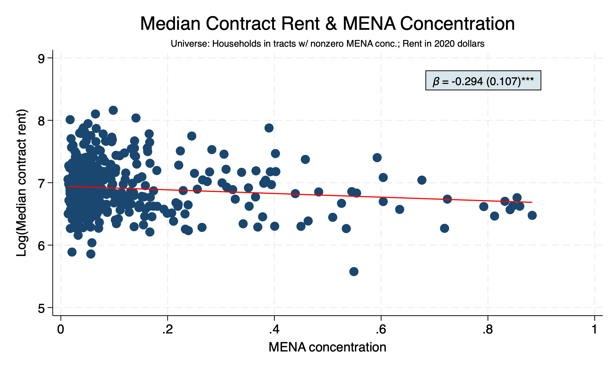

Slide 39
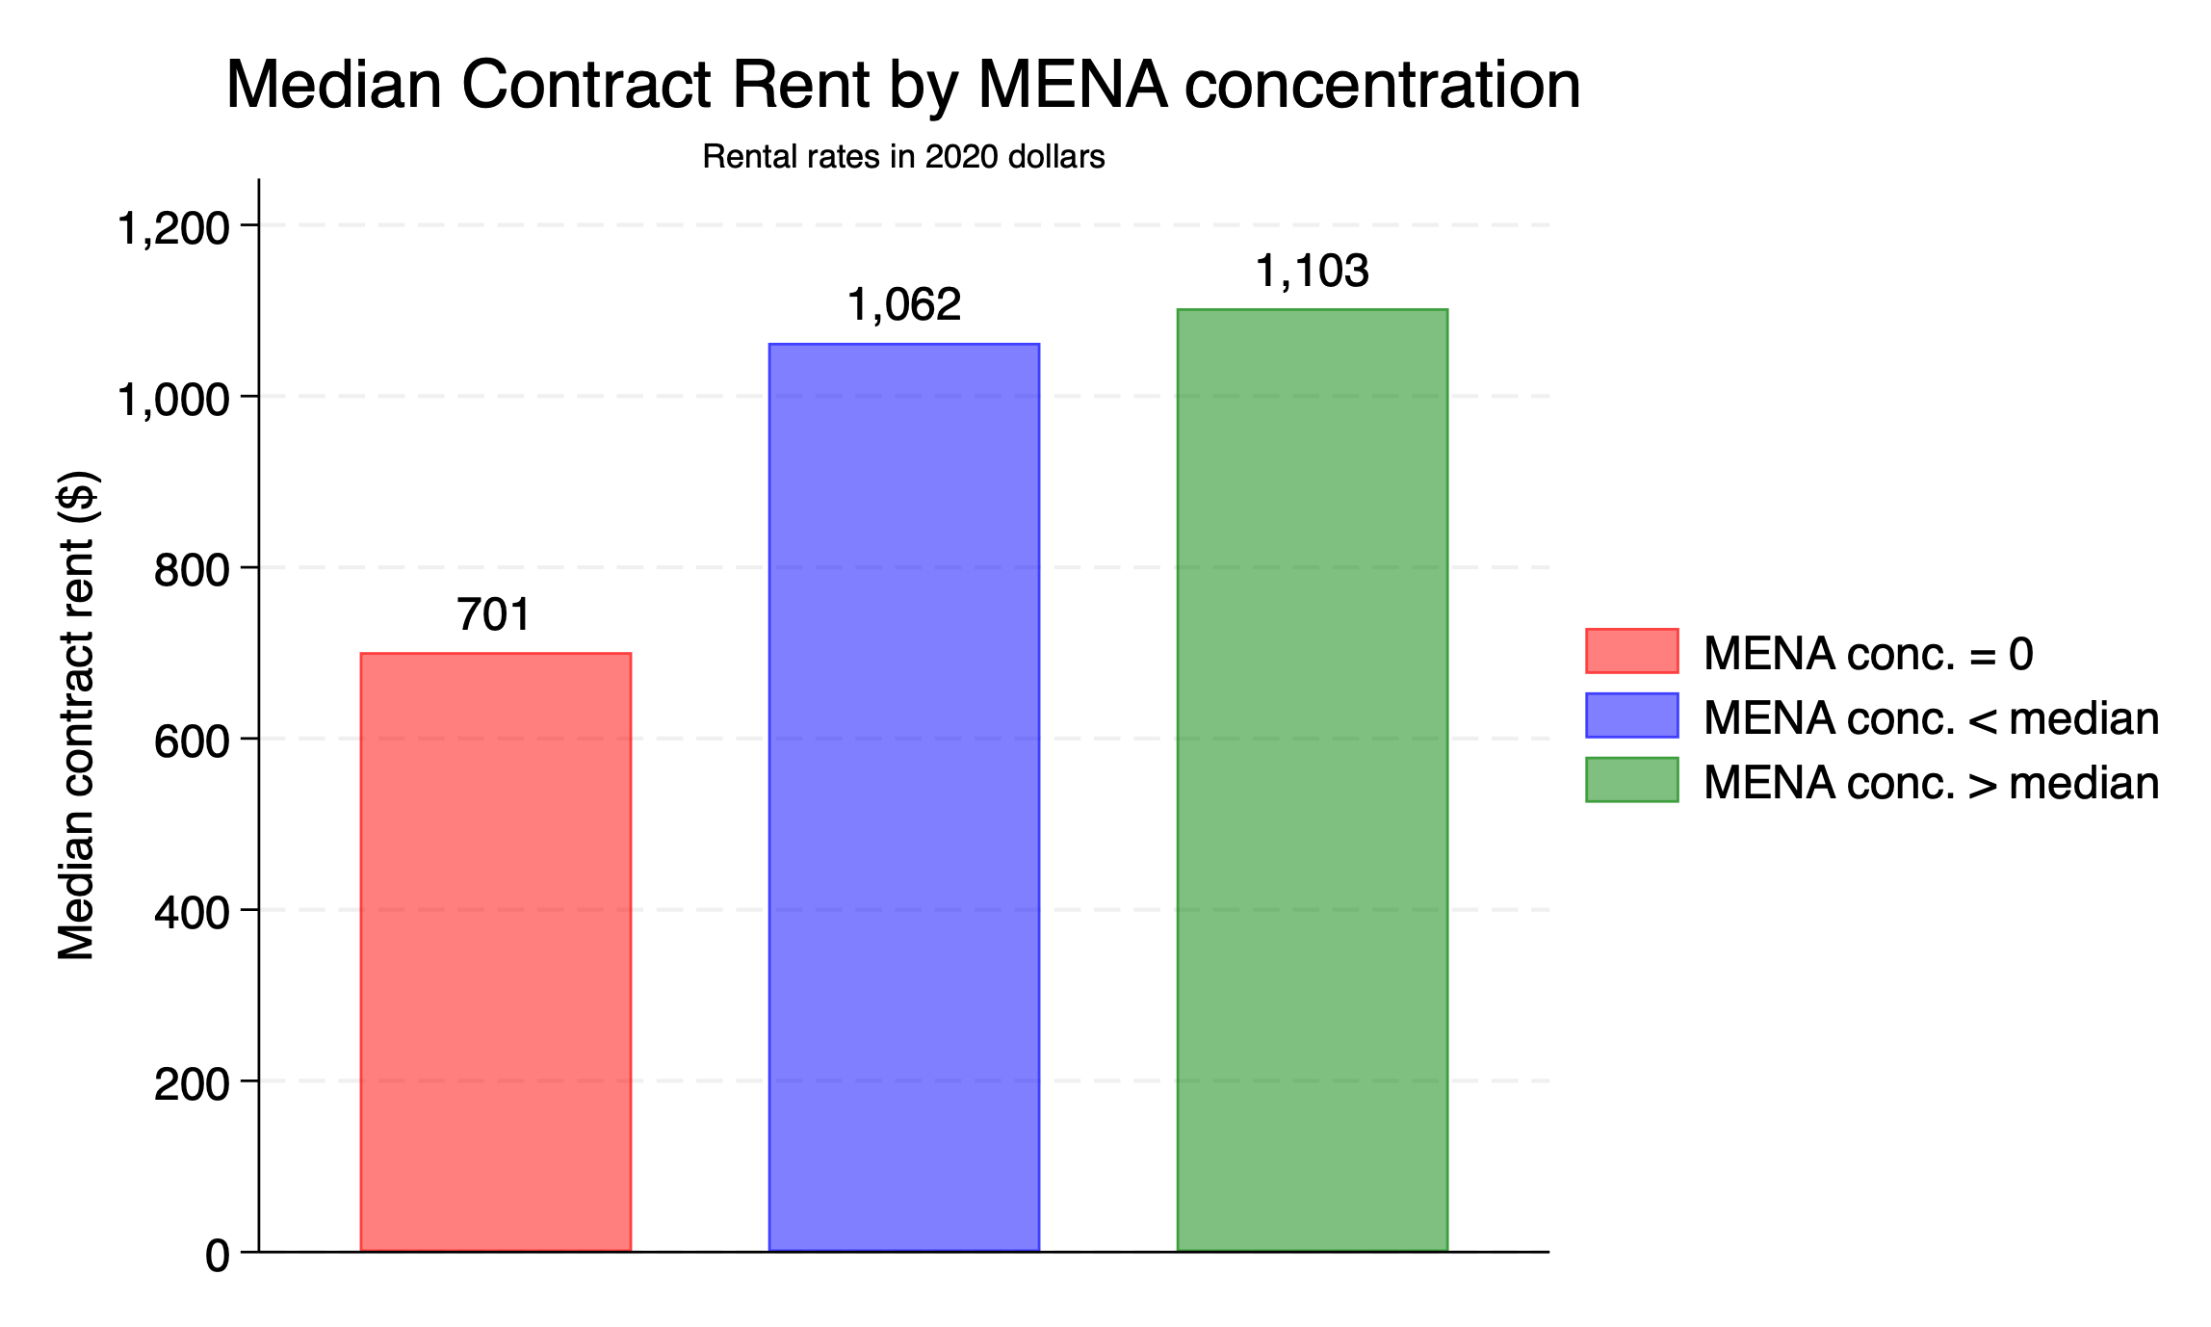

Slide 40
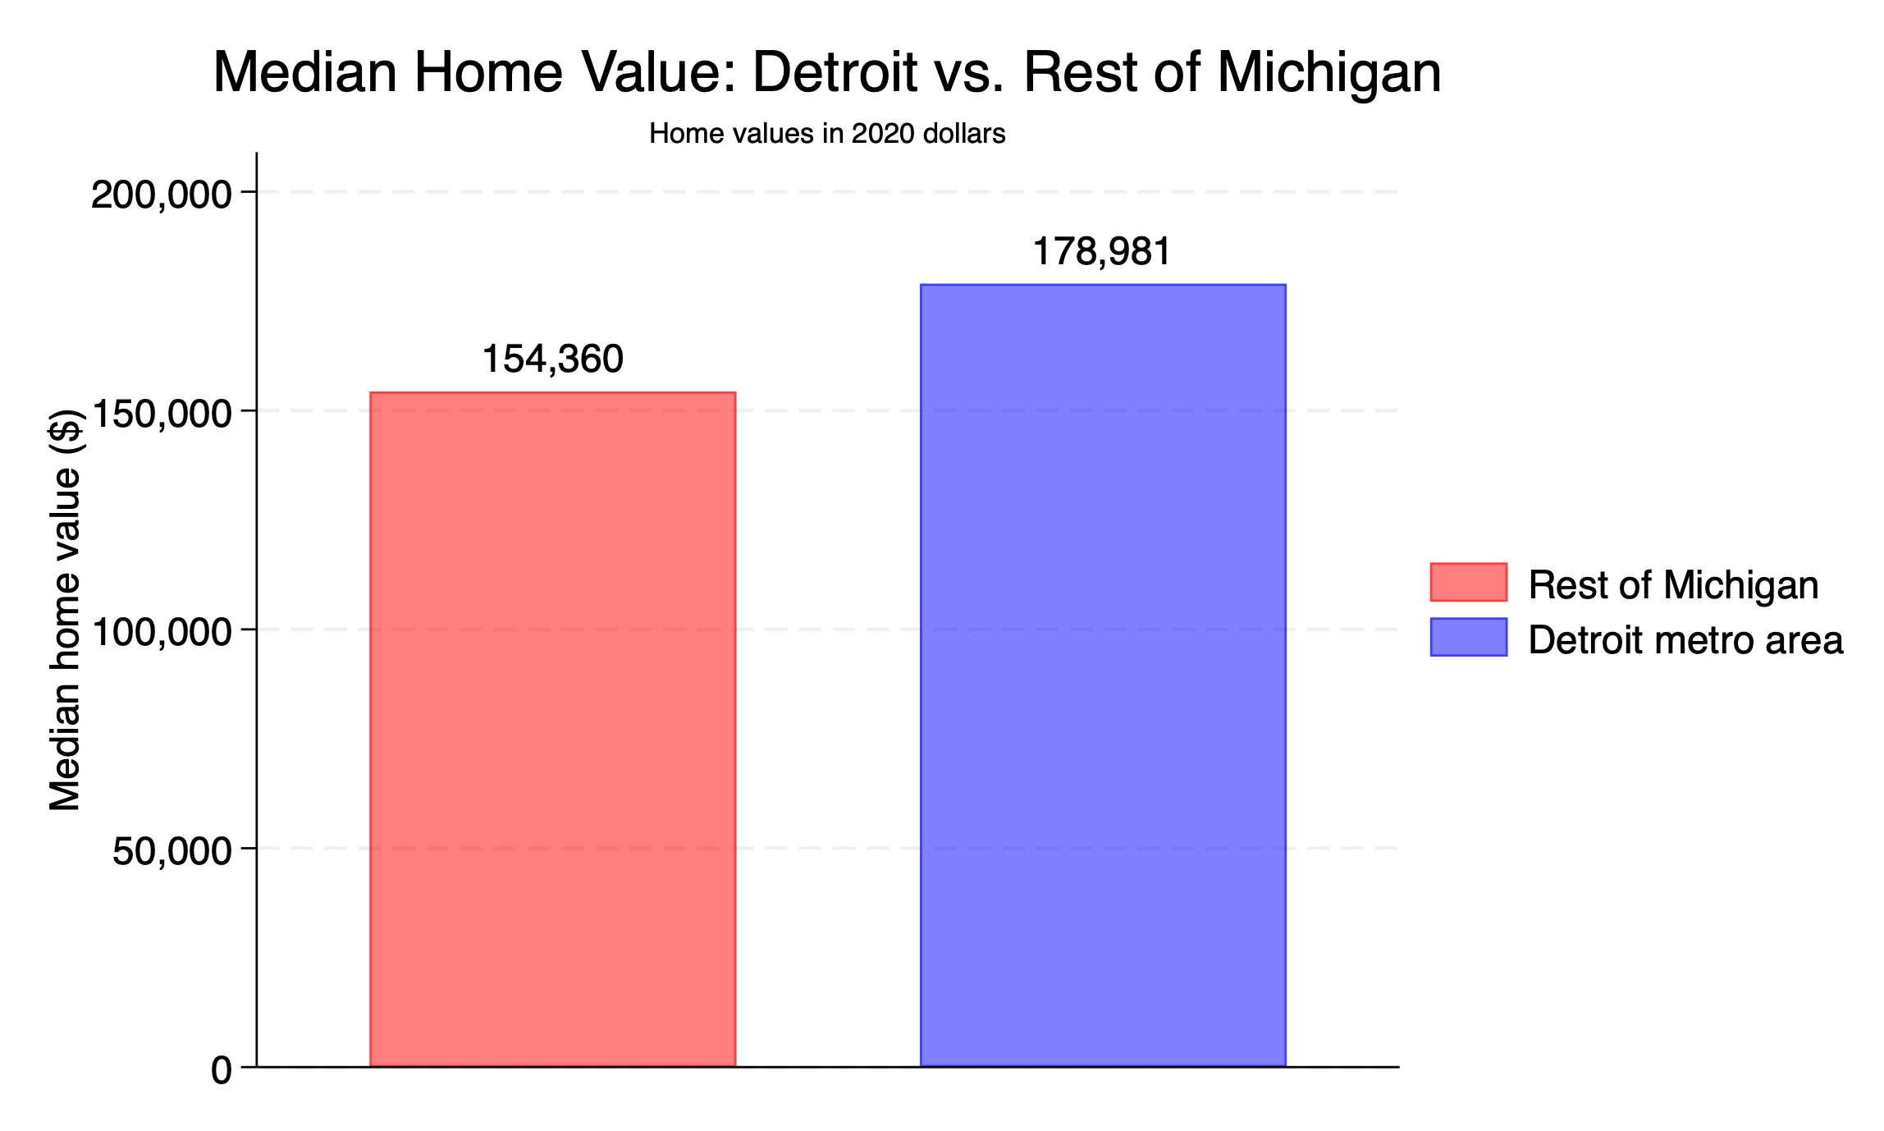

Slide 41
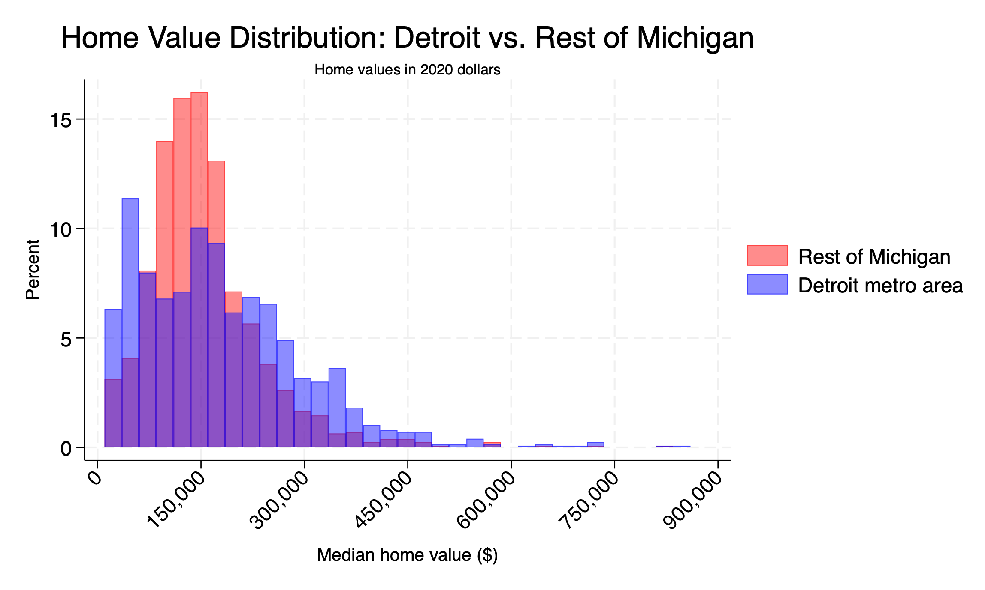

Slide 42
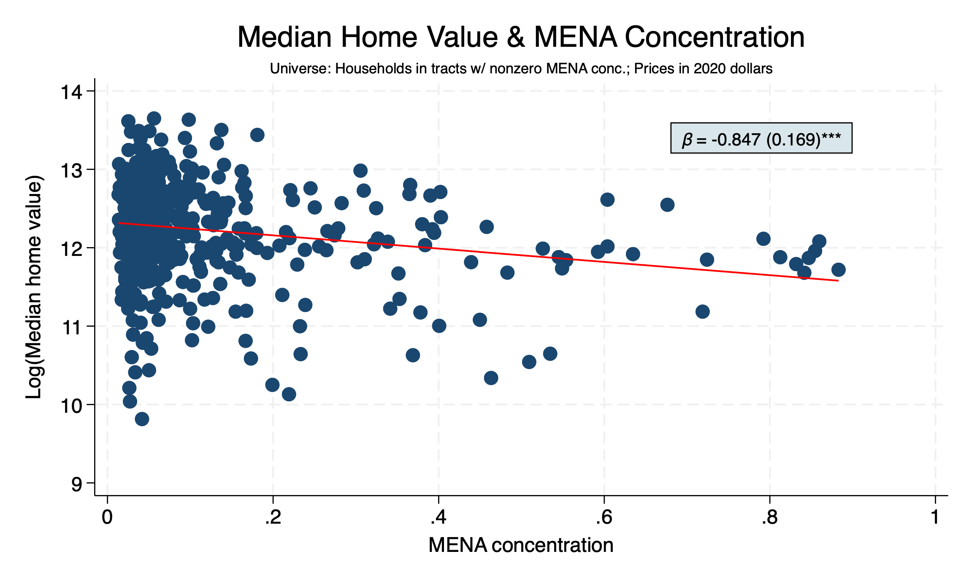

Slide 43
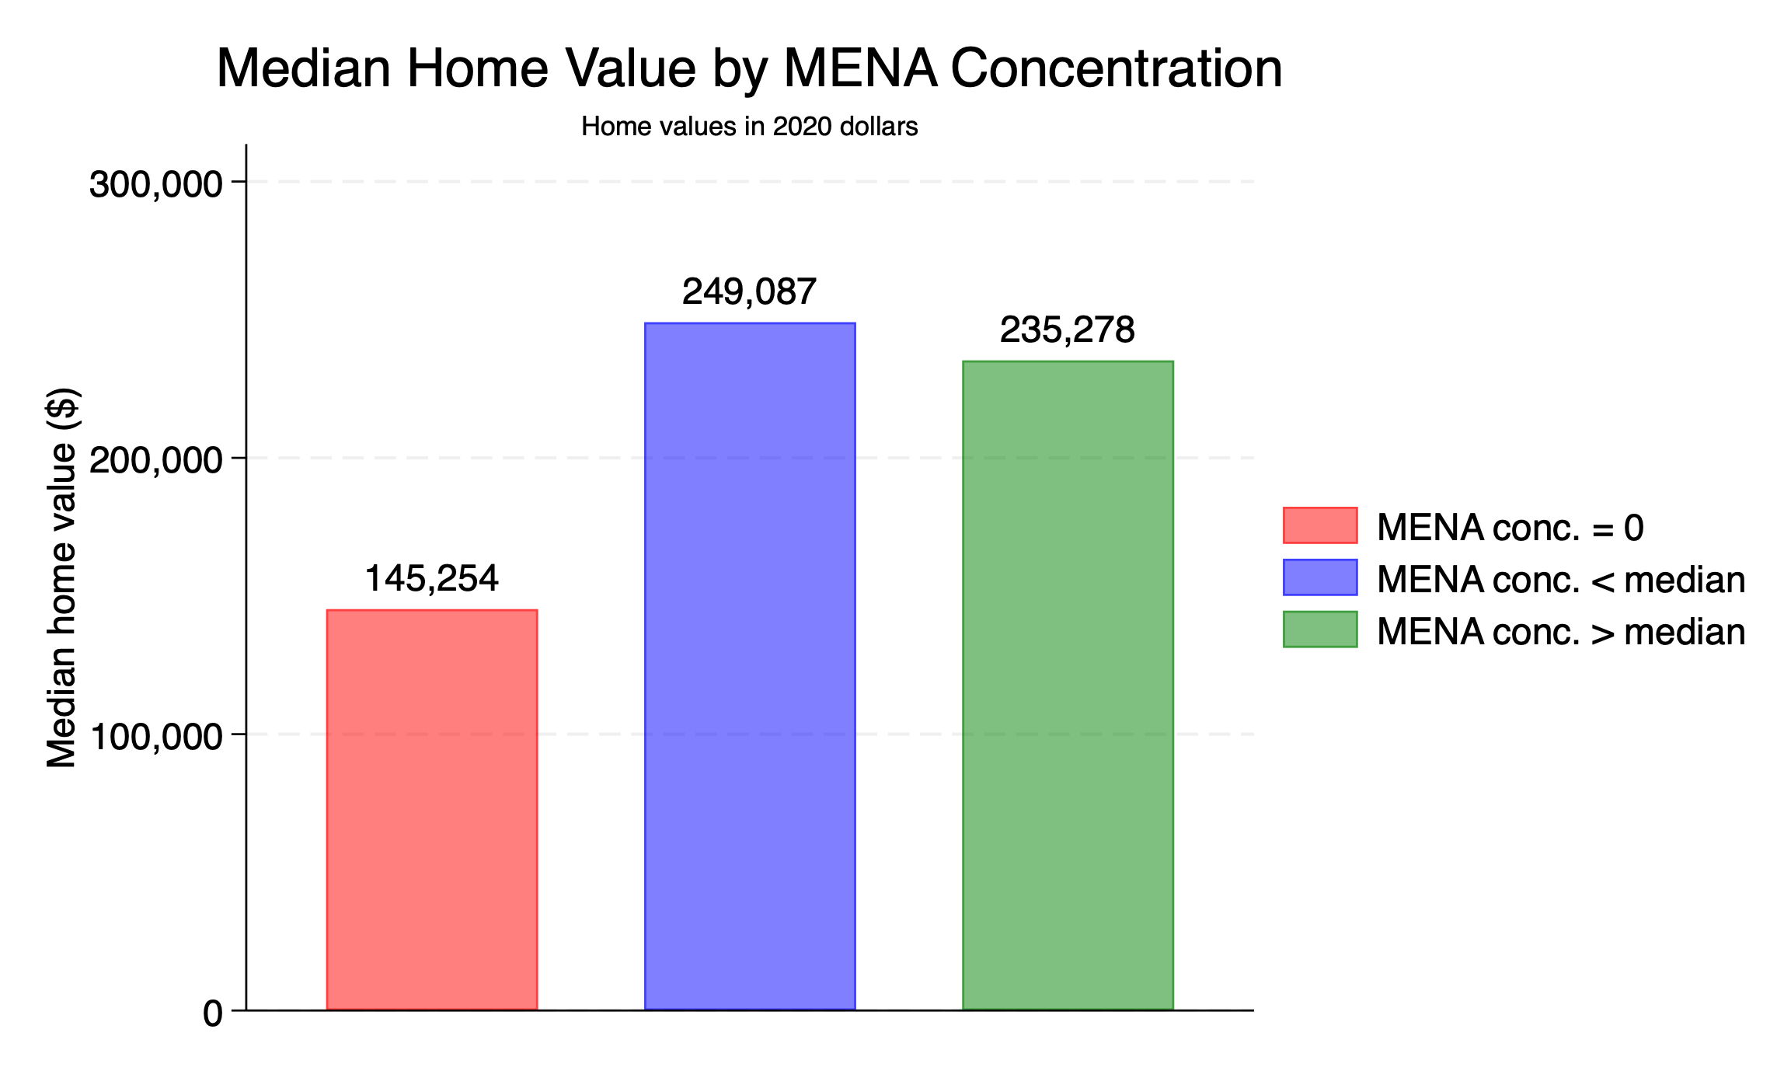

Slide 44
EDUCATION

Slide 45
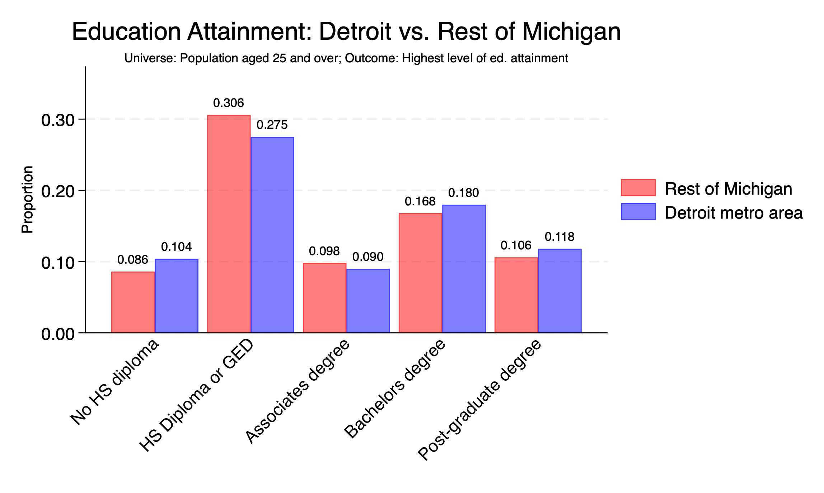

Slide 46
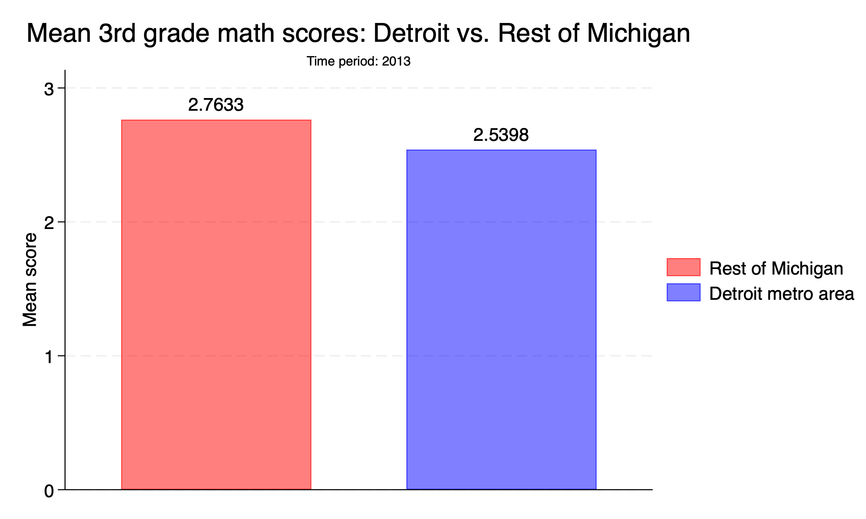
Notes:
Still don’t know what the scoring system is

